Slide 1
What are Environmental Exposures?
…and how can they enhance my study?
Notes:
Welcome to this HHEAR educational module – What are environmental exposures? And how can they enhance my study?

Slide 2
Objectives
Introduce environmental exposures
Describe how biological specimens could be used to assess environmental exposures
Highlight examples of which environmental samples are used for environmental exposure analysis
Describe why including environmental exposure data will enhance a study
Notes:
The objectives of this module are to:
-Introduce environmental exposures
-Describe how biological specimens could be used to assess environmental exposures
-Highlight examples of which environmental samples are used for environmental exposure analysis
And, finally,
-Describe why including environmental exposure data will enhance a study

Slide 3
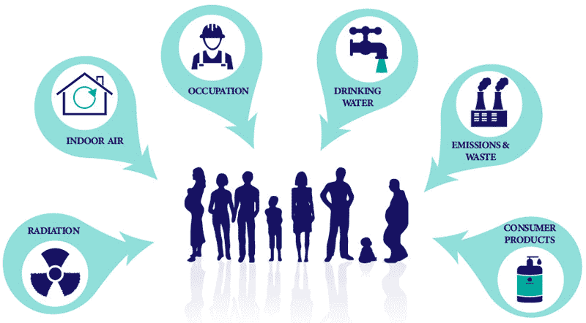
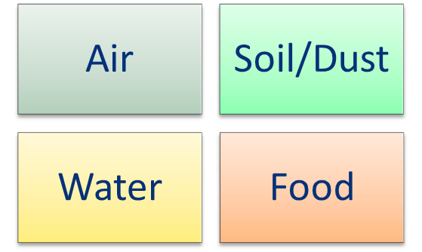
Introduction to Environmental Exposures (1 of 4)
What are environmental exposures?
The chemicals and compounds we come in contact within our environment
NCI 2023
Source: https://epi.grants.cancer.gov/chemical-physical-exposures/
Notes:
Let’s start with answering the question: What are environmental exposures?
Environmental exposures are exposures that include the chemicals and compounds we come in contact within our environment – our air, soil/dust, water, or food
Reference:
Figure: https://epi.grants.cancer.gov/chemical-physical-exposures/

Slide 4
Introduction to Environmental Exposures (2 of 4)
Exposure routes:
Notes:
Exposure to these contaminants generally occurs by one of three exposure routes: ingestion, inhalation, or dermal contact

Slide 5
Introduction to Environmental Exposures (3 of 4)
Environmental Exposures and Health
Some environmental exposures may increase the risk of certain diseases, such as heart disease, cancer, and respiratory diseases
Adverse health effects caused by an environmental exposure will depend on
the type and amount of chemical
the combination of chemicals
the route of exposure
the duration and frequency of exposure
at what age or life stage is someone exposed
Notes:
While environmental exposures can cause acute illness, it is important to understand that some environmental exposures may increase the risk of certain diseases, such as heart disease, cancer, and respiratory diseases
-Adverse health effects caused by an environmental exposure will depend on several factors including:
the type and amount of chemical an individual was exposed to
the combination of chemicals
the route of said exposure
the duration and frequency of the exposure
and even at what age or life stage someone is exposed

Slide 6
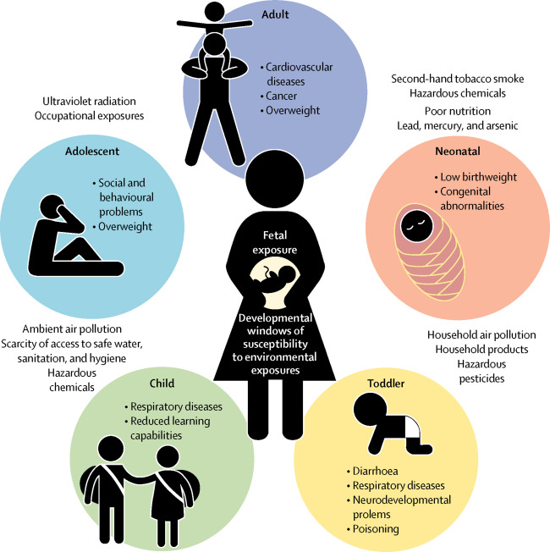
Introduction to Environmental Exposures (4 of 4)
Early life environmental exposures can affect development at critical life stages
Source: Poore et al. 2017 Lancet Planetary Health
Notes:
These environmental exposures to air pollution, contaminated food and water, and toxic substances, especially early in life, can affect development at ALL critical life stages… from the embryo through childhood and into adolescence
Reference: Poore, K.R., Hanson, M.A., Faustman, E.M., Neira, M., 2017. Avoidable early life environmental exposures. The Lancet Planetary Health 1, e172–e173. https://doi.org/10.1016/S2542-5196(17)30048-7

Slide 7
Factors Affecting Susceptibility
Susceptibility Factors – Intrinsic & Extrinsic
Age
Lifestage
Gender
Race/ethnicity
Genetic polymorphisms
Disease status
Socioeconomic status
Nutrition status
Geographic proximity
Lifestyle
Notes:
Now that we’ve discussed what environmental exposures are and routes of exposure, let’s talk about factors affecting an individual’s susceptibility to health outcomes of interest.
For example: an individual’s lifestage might affect his or her susceptibility to chemicals or pollutants. Different population groups might experience varying susceptibilities.
There are both intrinsic and extrinsic (or acquired) factors that affect an individual’s susceptibility to contaminants
-Susceptibility factors for individuals include lifestage, gender, genetic polymorphisms, socioeconomic status, disease status, nutritional status, geographic proximity to sources of exposure, and various lifestyle choices.
-Additionally, Toxicokinetic differences among individuals affecting how easily a chemical is absorbed, metabolized, and excreted are also important factors.
Reference: https://www.epa.gov/expobox/exposure-assessment-tools-lifestages-and-populations-highly-exposed-or-other-susceptible

Slide 8
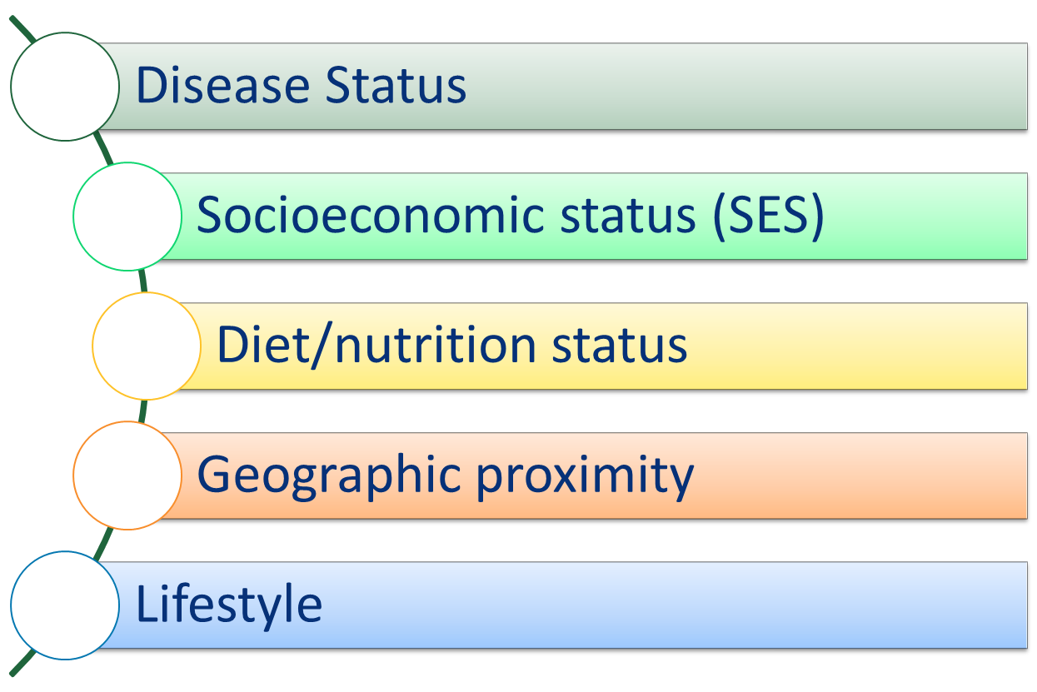
Extrinsic Population Factors Affecting Exposure
Population Exposure Factors:
Notes:
In addition to personal susceptibility factors, behaviors and geographical location influence what, when, and how much of the environmental contaminants someone is exposed to
At a population-level, factors to consider that could affect exposure include disease status, socioeconomic status, diet/nutrition status, geographic proximity, and lifestyle.
When researching environmental exposures & health outcomes, be sure to consider how some population groups may be predisposed to higher exposure rates than the general population due to cultural or economic factors.
Reference:
https://www.epa.gov/expobox/exposure-assessment-tools-lifestages-and-populations-highly-exposed-or-other-susceptible

Slide 9
Introduction to Environmental Exposures (1 of 2)
A few examples include:
Use of traditional cookstoves
Toddler hand-to-mouth behavior
Arsenic in well water
Ramirez et al. 2014 Energy Policy
NYC.gov 2019
USGS 2017
Notes:
A few examples of social and behavioral influences on environmental exposures include
-Populations in locations that use cookstoves for meal preparation that are exposed to the air pollutants from the stove
-Young children are more likely to be exposed to dust and soil than adults since they are frequently on the ground and put their hands in their mouths
-Communities using well water in an area with naturally high occurring arsenic are likely to have higher levels of arsenic detected in their blood than communities with very low arsenic levels
References:
Cookstove images:
Ramirez, S., Dwivedi, P., Ghilardi, A., Bailis, R., 2014. Diffusion of non-traditional cookstoves across western Honduras: A social network analysis. Energy Policy 66, 379–389. https://doi.org/10.1016/j.enpol.2013.11.008
Young, B.N., Clark, M.L., Rajkumar, S., Benka-Coker, M.L., Bachand, A., Brook, R.D., Nelson, T.L., Volckens, J., Reynolds, S.J., L’Orange, C., Good, N., Koehler, K., Africano, S., Osorto Pinel, A.B., Peel, J.L., 2019. Exposure to household air pollution from biomass cookstoves and blood pressure among women in rural Honduras: A cross-sectional study. Indoor Air 29, 130–142. https://doi.org/10.1111/ina.12507
Toddler hand to mouth https://www.nyc.gov/site/doh/about/press/pr2019/child-blood-lead-testing.page
Arsenic wells US: https://www.usgs.gov/news/national-news-release/study-estimates-about-21-million-people-using-wells-high-arsenic

Slide 10
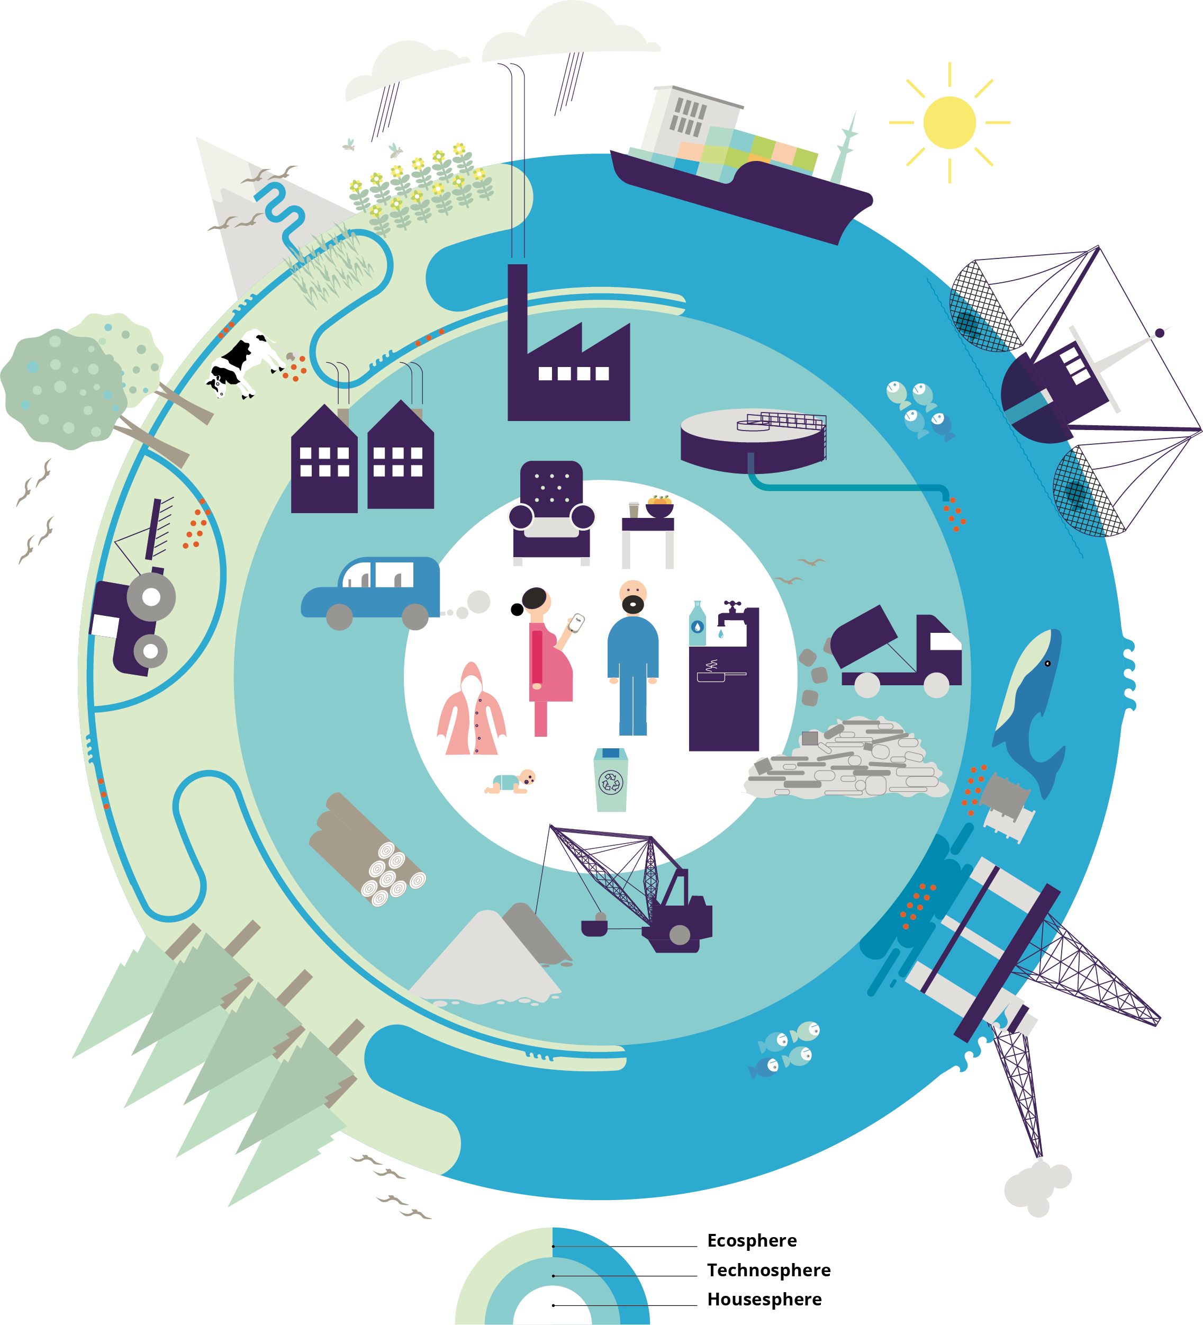
Introduction to Environmental Exposures (2 of 2)
The environment can include
Pesticides and other agricultural chemicals
Geogenic toxins
Personal care products
Industrial pollutants
Pharmaceuticals
Lifestyle factors (Smoking, secondhand smoke exposure, stress, nutrition, etc.)
Source: EEA. 2019
**Analysis of external exposures, biological responses, and host susceptibility can help establish links between environmental exposures and health outcomes.
Notes:
Remember, when we talk about environmental exposures, the term environment can include
Pesticides and other agricultural chemicals that may find their way into our food and water
Geogenic toxins
Personal care products like cosmetics and sunscreens that we put on our skin
Industrial pollutants in the air we breathe and Chemicals found in the products and building materials we use
Pharmaceuticals
The influence of lifestyle factors such as smoking, secondhand smoke exposure, stress, and nutrition
Analysis of these external exposures, biological responses, and host susceptibility can help establish links between environmental exposures and health outcomes.
References:
EEA 2019: https://www.eea.europa.eu/soer/publications/soer-2020
EEA, 2019. The European environment: state and outlook 2020 : knowledge for transition to a sustainable Europe. Publications Office, LU.

Slide 11

Approaches
Two Approaches
Targeted approach (compounds and chemicals of interest are specified)
Untargeted approach (discovery approach of what compounds are in the samples)
Notes:
When studying environmental exposures, there are two types of laboratory approaches:
First is the Targeted approach in which the compounds and chemical elements of interest are specified…
Second is the Untargeted approach this is more of a discovery approach or a hypothesis generating approach to identify what compounds are in the samples.
Reference:
Image: https://www.vectorstock.com/royalty-free-vector/science-research-and-analysis-concept-vector-5959485

Slide 12
Glossary
Term | Definition
Traditional biomonitoring/targeted analyses | Analyses of biological samples for specific chemicals: either exposures or markers of exposures
Semi-targeted/hybrid approaches | Exploits the advantages of both targeted and untargeted approaches: for example, using metabolomics for discovery of potential exposures followed by targeted analysis for a more fully quantitative measure
Untargeted analyses | Agnostic analyses that can measure a broad set of endogenous and exogenous metabolites in one sample run
Source: Dennis et al. 2017 Environ. Health Perspect.
Notes:
To provide further context, a glossary of some key terms to support measuring environmental exposures includes terms from the Dennis et al. 2017 article in Environmental Health Perspectives.
-Again, targeted analyses will analyze biological samples for specific chemicals, which can be either exposures or markers of exposures
-Untargeted analyses use techniques to promote identification of unknown/emerging exposures of concern and aims to measure biologically meaningful lifetime exposures, both exogenous and endogenous. This untargeted approach enables detection of “features” that are linked to exposure or disease for further confirmation
-And semi-targeted analyses combines targeted and untargeted approaches. As an example, this can be done using metabolomics for discovery of potential exposures followed by targeted analysis for a more fully quantitative measure.
Reference:
Glossary extracted from: Dennis, K.K., Marder, E., Balshaw, D.M., Cui, Y., Lynes, M.A., Patti, G.J., Rappaport, S.M., Shaughnessy, D.T., Vrijheid, M., Barr, D.B., 2017. Biomonitoring in the Era of the Exposome. Environmental Health Perspectives 125, 502–510. https://doi.org/10.1289/EHP474

Slide 13
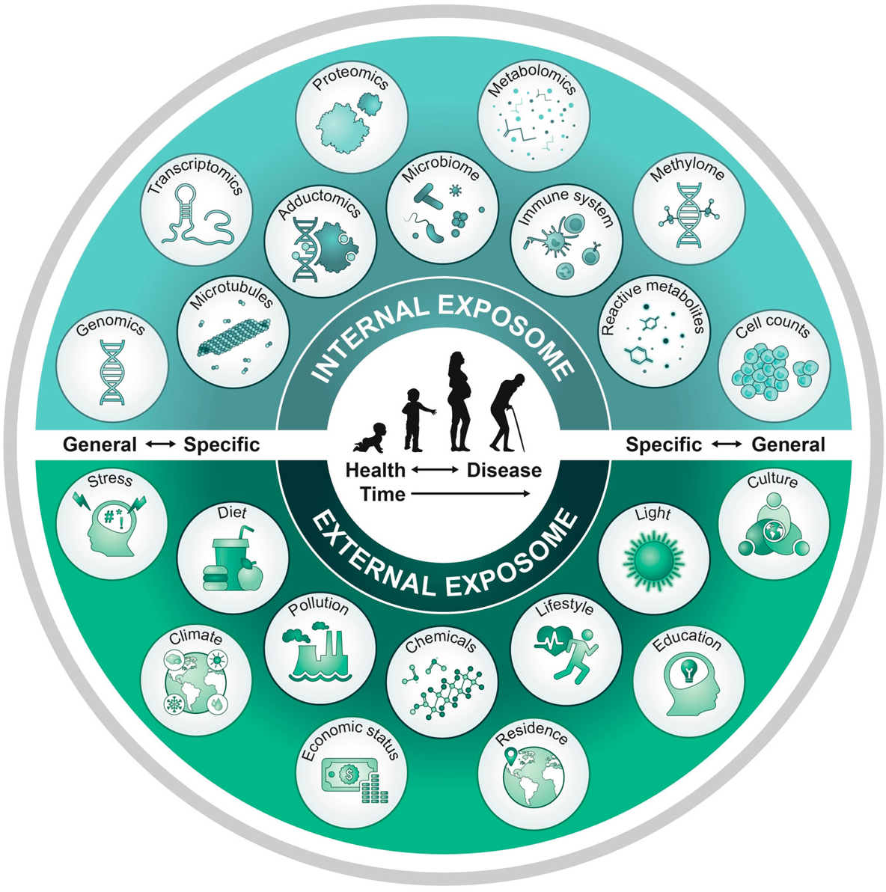
Exposome (1 of 2)
The Exposome
Is the totality of exposures throughout the lifespan (from conception to death) –Wild 2005
Includes the cumulative measure of exposures to both chemical and non-chemical agents such as diet, stress, and sociobehavioral factors
Source:
Zhang et al. 2021 Environ. Sci. Technol
Notes:
So far we have established what environmental exposures are, routes of exposure, and approaches to analysis…
But we are exposed to a variety of chemicals/compounds through out our lives, so you might be asking yourself, what about the cumulative impact of these exposures – well, this is the concept of the exposome
-The exposome is defined as the totality of exposures throughout the lifespan (from conception to death) (Wild 2005)
-The exposome includes the cumulative measure of exposures to both chemical and non-chemical agents such as diet, stress, and sociobehavioral factors
Reference:
Wild CP. Complementing the genome with an "exposome": the outstanding challenge of environmental exposure measurement in molecular epidemiology. Cancer Epidemiol Biomarkers Prev. 2005;14(8):1847-1850. doi:10.1158/1055-9965.EPI-05-0456
Image: Zhang et al. 2021
Zhang, P., Carlsten, C., Chaleckis, R., Hanhineva, K., Huang, M., Isobe, T., Koistinen, V.M., Meister, I., Papazian, S., Sdougkou, K., Xie, H., Martin, J.W., Rappaport, S.M., Tsugawa, H., Walker, D.I., Woodruff, T.J., Wright, R.O., Wheelock, C.E., 2021. Defining the Scope of Exposome Studies and Research Needs from a Multidisciplinary Perspective. Environ. Sci. Technol. Lett. 8, 839–852. https://doi.org/10.1021/acs.estlett.1c00648

Slide 14
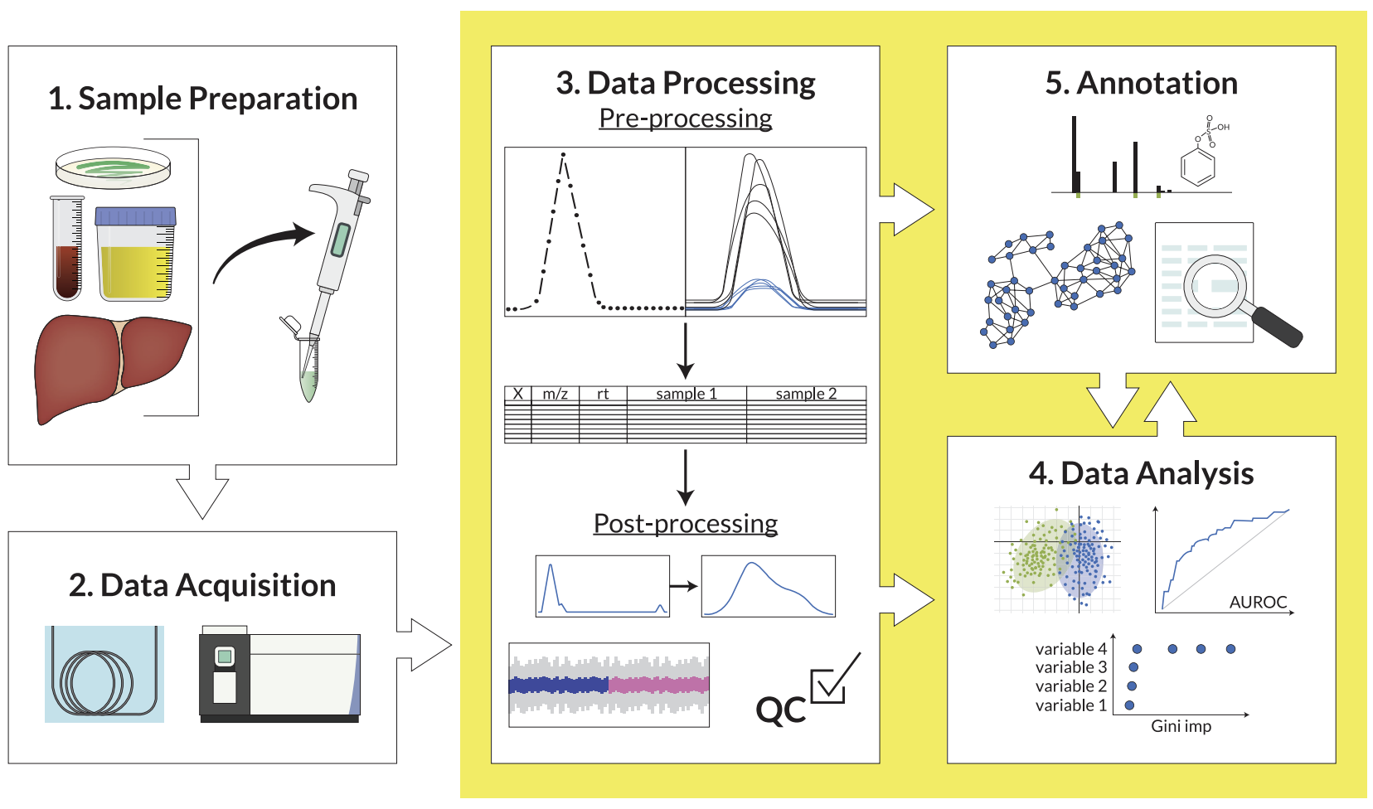
Exposome (2 of 2)
Measurement includes quantitative and repeated metrics of exposures
Exposomic approaches aim to capture all exposures that potentially affect health and disease
This includes untargeted discovery of unknown chemicals of biological importance
Source: Petrick and Shomron 2022 Cell Rep
Notes:
Measurement of the exposome includes a series of quantitative and repeated metrics of exposures – both from internal and external factors – that describe, holistically, environmental influences or exposure over a lifetime
Exposomic approaches go a step beyond traditional biomonitoring, with the aim to capture all exposures that potentially affect health and disease.
This includes untargeted discovery of unknown chemicals of biological importance
Reference:
Petrick, L.M., Shomron, N., 2022. AI/ML-driven advances in untargeted metabolomics and exposomics for biomedical applications. Cell Reports Physical Science 3, 100978. https://doi.org/10.1016/j.xcrp.2022.100978

Slide 15


Role of Environmental Exposures on Human Health (1 of 3)
HHEAR measures human environmental exposures
Chemical, physical, and biological stressors
Lifestyle (i.e., nutrition, smoking)
Measure biomarkers and environmental samples for targeted and untargeted analyses
Notes:
The wide range of exposures of occurring over the life course highlights the importance of answering the question: What is the role of environmental exposures affecting human health?
HHEAR, the Human Health Exposure Analysis Resource, measures human environmental exposures, Including:
chemical, physical, and biological stressors
Lifestyle, such as nutrition and smoking
As well as, measurements of environmental exposures within different social environments
This is done measuring biomarkers and environmental samples for targeted and untargeted analyses

Slide 16
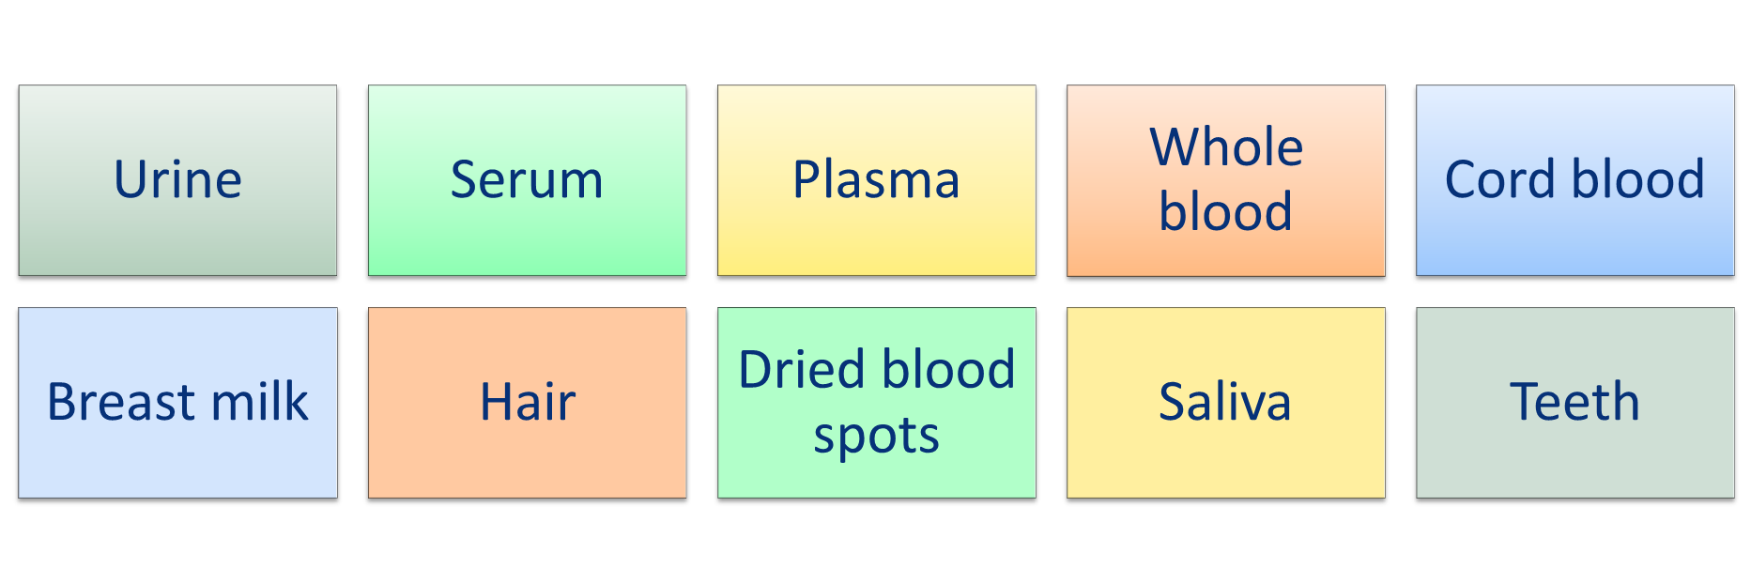
Role of Environmental Exposures on Human Health (2 of 3)
Examples of what sample matrices can measure environmental exposures
Notes:
HHEAR can measure environmental exposures through a variety of biological specimen,
including:
Urine
Serum
Whole blood
Cord blood and
Breast milk

Slide 17



Role of Environmental Exposures on Human Health (3 of 3)
HHEAR also accepts environmental samples for applications (e.g. water, air, dust, soil, food, silicone wristbands)
Notes:
Environmental exposures can also be measured using environmental samples, such as from water, air, dust, soil, food, silicone wristbands.
-Note that HHEAR also accepts these environmental samples for applications, but this module provides a greater focus on providing information for biological specimens
Reference:
Images:
Water: https://www.niehs.nih.gov/health/topics/agents/water-poll/index.cfm
Dust: https://www.shutterstock.com/search/house-dust
Silicone wristbands: https://www.thewristbandman.com/products/solid-silicone-wristbands

Slide 18
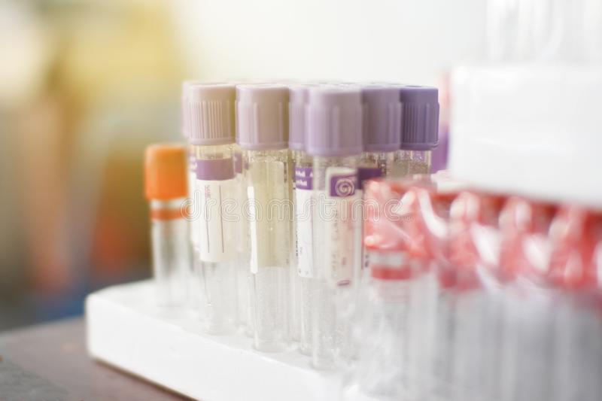

Assessing biological specimens (1 of 2)
Types of samples available
Remaining amount
Collection methods
Storage conditions
Consider the time(s) of sample collection
At what time point(s) did you collect samples?
Notes:
If you have biological specimens and you are interested in environmental exposure analysis, it’s important to first think about what types of samples you have available – including how much is left or available for further analysis, the collection methods, and storage conditions.
Consider the time(s) of sample collection
-At what time point(s) did you collect samples?
-For example, if there were multiple collection times over time (longitudinal and potentially across various life stages) the study could assess for when people were exposed and if exposures are cumulative
Reference:
Image:
Tubes: https://www.dreamstime.com/hematology-blood-analysis-report-lavender-color-sample-collection-tubes-labels-proper-identification-background-hand-image145997612

Slide 19
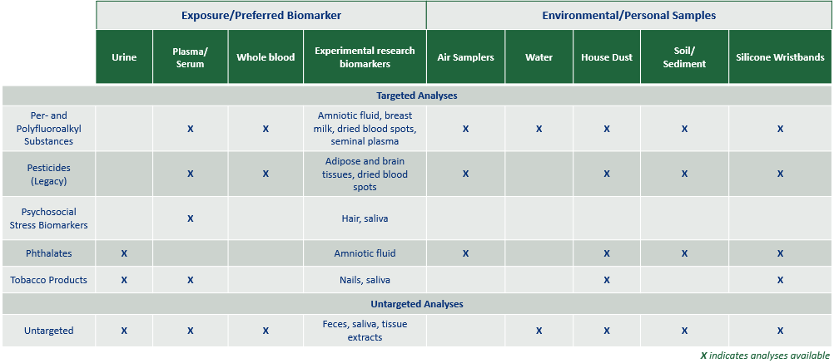
Example Matrix of HHEAR Laboratory Services
Source: https://hhearprogram.org/sample-matrix-table
Notes:
This is a sample matrix of laboratory services provided by HHEAR. You can visit the HHEAR website for a more exhaustive list of analyses available by matrix.
Note that on the left are matrices for clinical biospecimens, such as urine and blood, and on the right are environmental matrices, like water, dust, and silicone wristbands.
Reference:
https://hhearprogram.org/sample-matrix-table

Slide 20

Assessing biological specimens (2 of 2)
Additional considerations:
Half-life of compound in media
# of freeze-thaw cycles
Number of specimen collections
Have Questions?
Contact the HHEAR Coordinating Center at HHEARHelp@westat.com to request a pre-submission consultation
Notes:
For assessments of biological specimens, additional points to consider are:
- The Half-life of compound in media, which can be an important parameter to determine the extent of bioaccumulation or biological concentration
- the number of freeze-thaw cycles of samples
- And the number of specimen collections, which could be used to inform a temporal component in the assessment
-If you have questions about assessments, reach out to the HHEAR coordinating center at HHEARHelp@westat.com to schedule a consultation

Slide 21



Phthalate exposure
Adding environmental data further informs what we understand from clinical data
Example
Outcome: Childhood behavior
Exposure: Phthalates; multiple compounds
What sample quality and quantity are necessary to measure phthalates?
0.1 – 1.0 mL of urine or 1 gram of dust
No repeated freeze-thaw cycles
Source: Colicino et al. 2021 Environ Res
https://hhearprogram.org/exposure-phthalates
Notes:
Let’s explore an example:
If childhood behavior is an outcome of interest in your cohort, you could look for environmental contaminants that may be associated with childhood behavioral problems. Exposure to phthalates, for example, has been associated with reproductive developmental and neurotoxicological toxicity in humans. Many studies have linked prenatal exposure to phthalates with adverse health outcomes in newborns and children.
-Phthalates have been used as plasticizers and solvents over the past century.
-Phthalates are not chemically bound to the products they are added to, so they are released into the environment and enter our bodies through inhalation, ingestion, and dermal absorption.
-Phthalates have short half-lives (<24 hours) and they have been detected in human urine, blood, feces, amniotic fluid, breast mild, and sweat.
If you wanted to add this type of analysis to your study, you would want to ensure you have the necessary sample quality and quantity to measure phthalates…
Typically 0.1-1.0 mL of urine or 1.0 gram of dust are used. Smaller volumes can be used but usually translate to lower frequency of detection. Samples must have not undergone repeated freeze-thaw cycles and must have been collected to minimize phthalate contamination. [https://hhearprogram.org/exposure-phthalates]
-A study design may perform separate analyses for several phthalate metabolites. Note that, there is growing evidence that measuring the presence of multiple phthalates as well as additional chemicals will more accurately measure health risks compared to measuring individual phthalate concentrations.
Reference:
Colicino, E., de Water, E., Just, A.C., Navarro, E., Pedretti, N.F., McRae, N., Braun, J.M., Schnaas, L., Rodríguez-Carmona, Y., Hernández, C., Tamayo-Ortiz, M., Téllez-Rojo, M.M., Deierlein, A.L., Calafat, A.M., Baccarelli, A., Wright, R.O., Horton, M.K., 2021. Prenatal urinary concentrations of phthalate metabolites and behavioral problems in Mexican children: The Programming Research in Obesity, Growth Environment and Social Stress (PROGRESS) study. Environ Res 201, 111338. https://doi.org/10.1016/j.envres.2021.111338

Slide 22
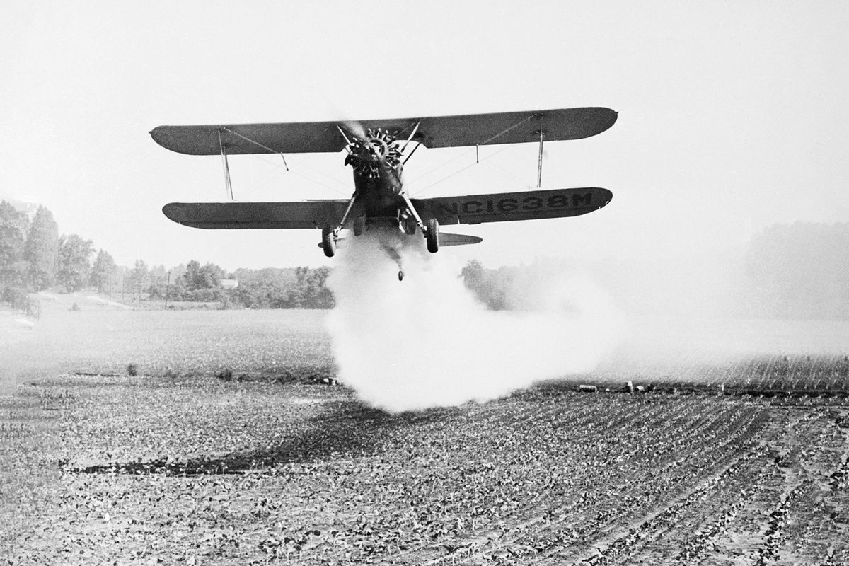

DDT exposure
Outcome: Alzheimer’s disease
Exposure: DDT (legacy pesticide dichlorodiphenyltrichloroethane)
The United States banned the use of DDT in 1972
DDT and its metabolite DDE is measured in serum
Persists for a long time in the environment and in animal tissues
Bettmann/Getty Images
Getty Images
Source: Kalia et al. 2022 PNAS Nexus
https://www.cdc.gov/biomonitoring/DDT_FactSheet.html#:~:text=The%20United%20States%20banned%20the,environment%20and%20in%20animal%20tissues.
Notes:
Now let’s look at an example of how environmental exposure data can enhance studies when Alzheimer’s disease is the clinical outcome of interest. Studies have demonstrated the legacy pesticide DDT is associated with Alzheimer’s disease.
Exposure to DDT in people likely occurs from eating foods, including meat, fish, and dairy products.
While the United States banned the use of DDT in 1972, some countries still use DDT to control mosquitoes that are vectors of disease, such as malaria
DDT and its metabolite DDE is typically measured in serum and persist for a long time in the body and environment
While research has demonstrated associations between DDT and Alzheimer’s disease, there are still opportunities to further explore other environmental contaminants that may be associated with a cohort with Alzheimer’s disease. Again, targeted and untargeted approaches can be used.
Reference:
https://www.cdc.gov/biomonitoring/DDT_FactSheet.html#:~:text=The%20United%20States%20banned%20the,environment%20and%20in%20animal%20tissues.
Kalia, V., Niedzwiecki, M.M., Bradner, J.M., Lau, F.K., Anderson, F.L., Bucher, M.L., Manz, K.E., Schlotter, A.P., Fuentes, Z.C., Pennell, K.D., Picard, M., Walker, D.I., Hu, W.T., Jones, D.P., Miller, G.W., 2022. Cross-species metabolomic analysis of tau- and DDT-related toxicity. PNAS Nexus 1, pgac050. https://doi.org/10.1093/pnasnexus/pgac050

Slide 23
Enhancing Studies (1 of 3)
Individuals are continuously exposed to chemicals, microbes and pollutants from the environment. These exposures have the potential to exacerbate disease, interact with our genes to promote disease, or alter metabolic processes. Including environmental exposure analysis when studying dynamic human health outcomes serves to create a more robust study result.
Notes:
Individuals are continuously exposed to chemicals, microbes and pollutants from the environment. These exposures have the potential to exacerbate disease, interact with our genes to promote disease, or alter metabolic processes. Including environmental exposure analysis when studying dynamic human health outcomes serves to create a more robust study result.

Slide 24
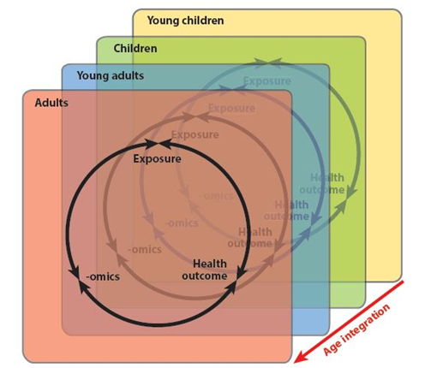
Enhancing Studies (2 of 3)
Beyond one study:
Merging data across different cohorts that have focused on shorter windows/specific life stages is an approach to simulate the life-course and explore changes in the exposome over time
Source: Stingone et al. 2017 Annu Rev Public Health
Notes:
Beyond one study…
Once we analyze study results, data from numerous studies can be harmonized to provide a better understanding of how health outcomes are associated with environmental exposures, subsequently informing health risks.
Merging data across different cohorts that have focused on shorter windows or specific life stages is an approach to simulate the life-course and explore changes in the exposome over time
This figure shows how exposure is linked to health end points, using advanced exposure science technologies including -omics within each critical life stage, and then these are integrated across life stages for a life-course view.
Reference:
Stingone, J.A., Buck Louis, G.M., Nakayama, S.F., Vermeulen, R.C.H., Kwok, R.K., Cui, Y., Balshaw, D.M., Teitelbaum, S.L., 2017. Toward Greater Implementation of the Exposome Research Paradigm within Environmental Epidemiology. Annu Rev Public Health 38, 315–327. https://doi.org/10.1146/annurev-publhealth-082516-012750

Slide 25
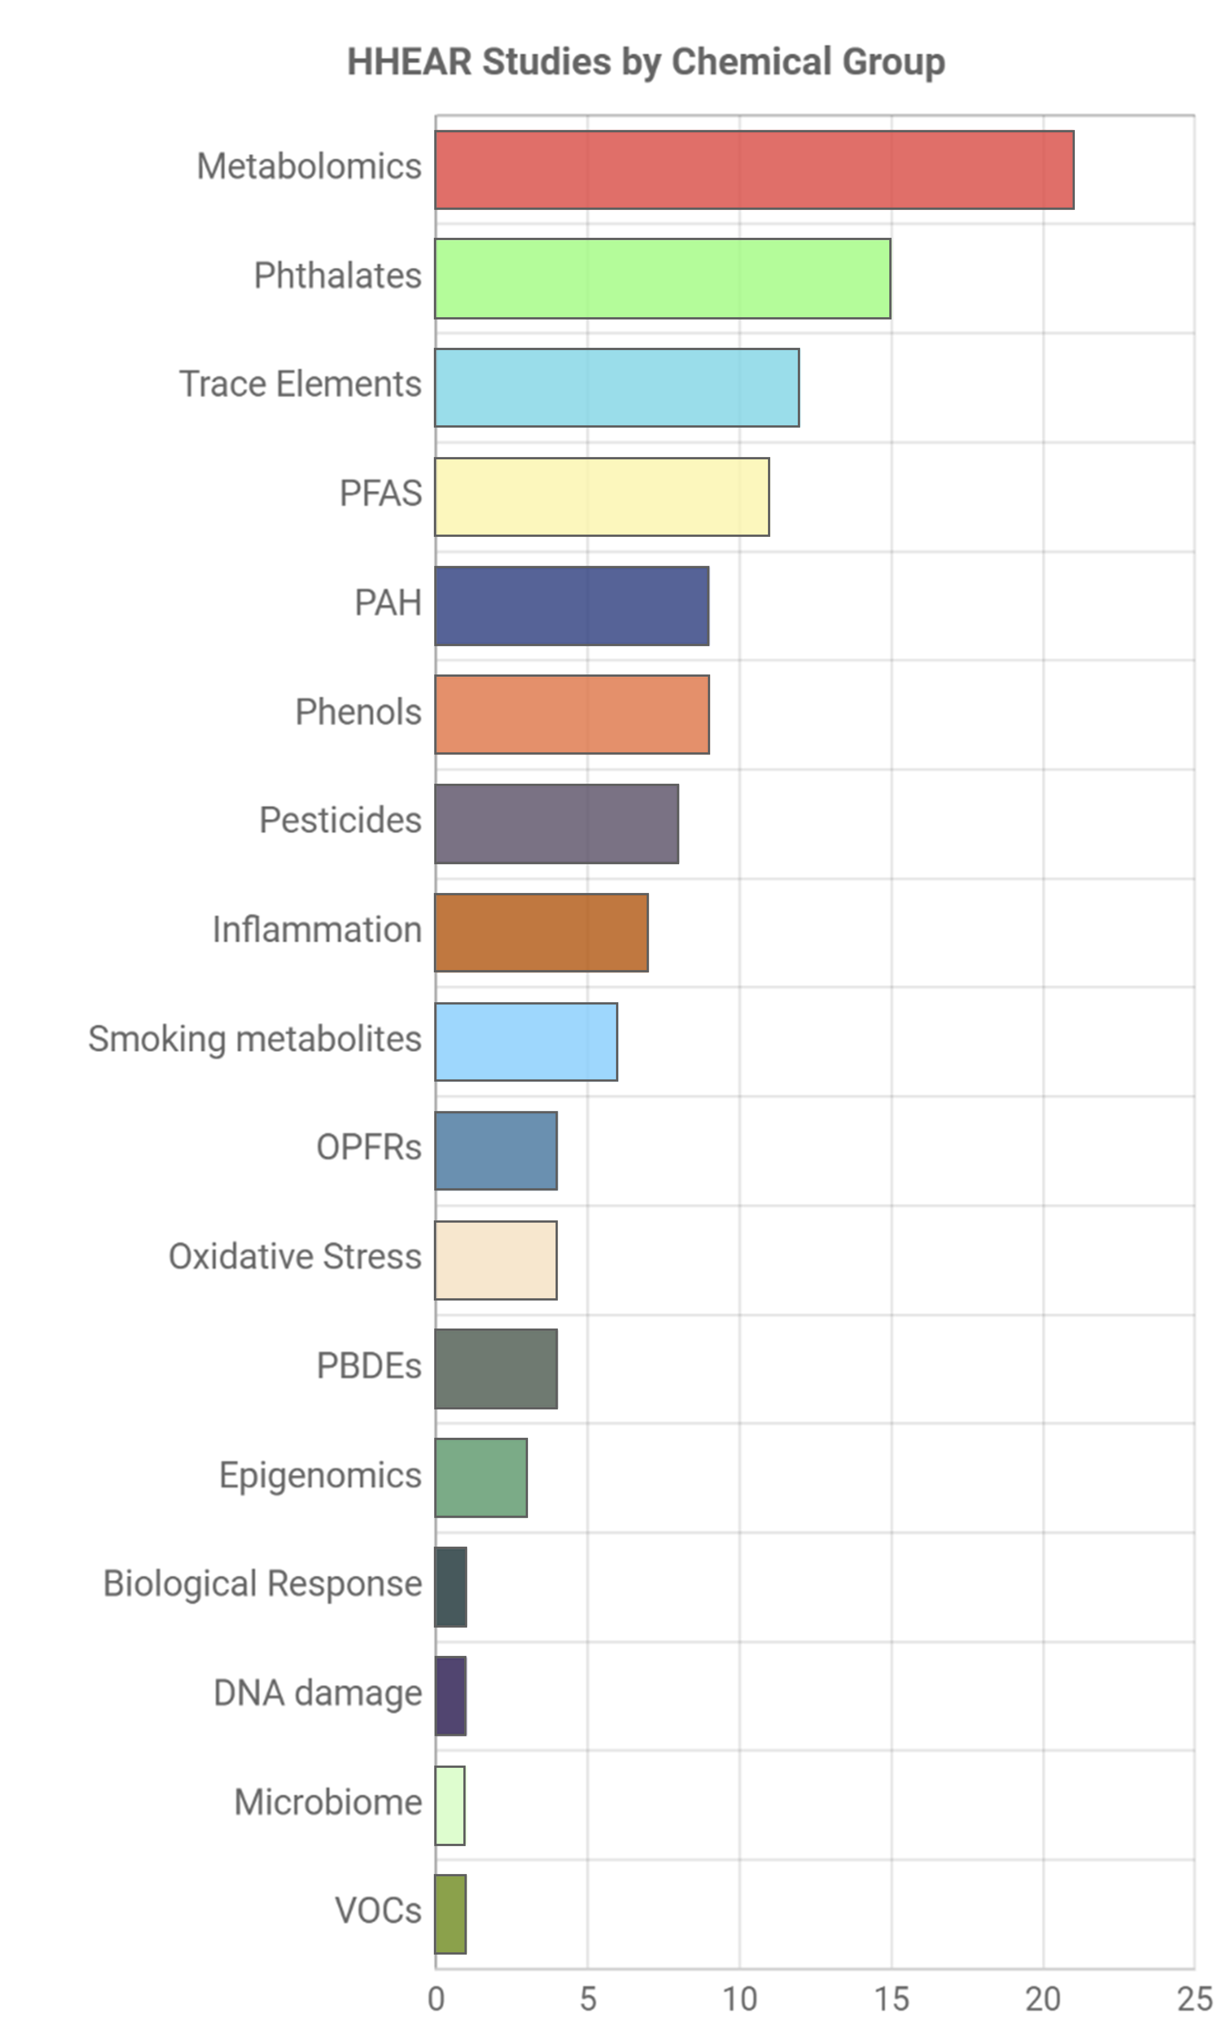
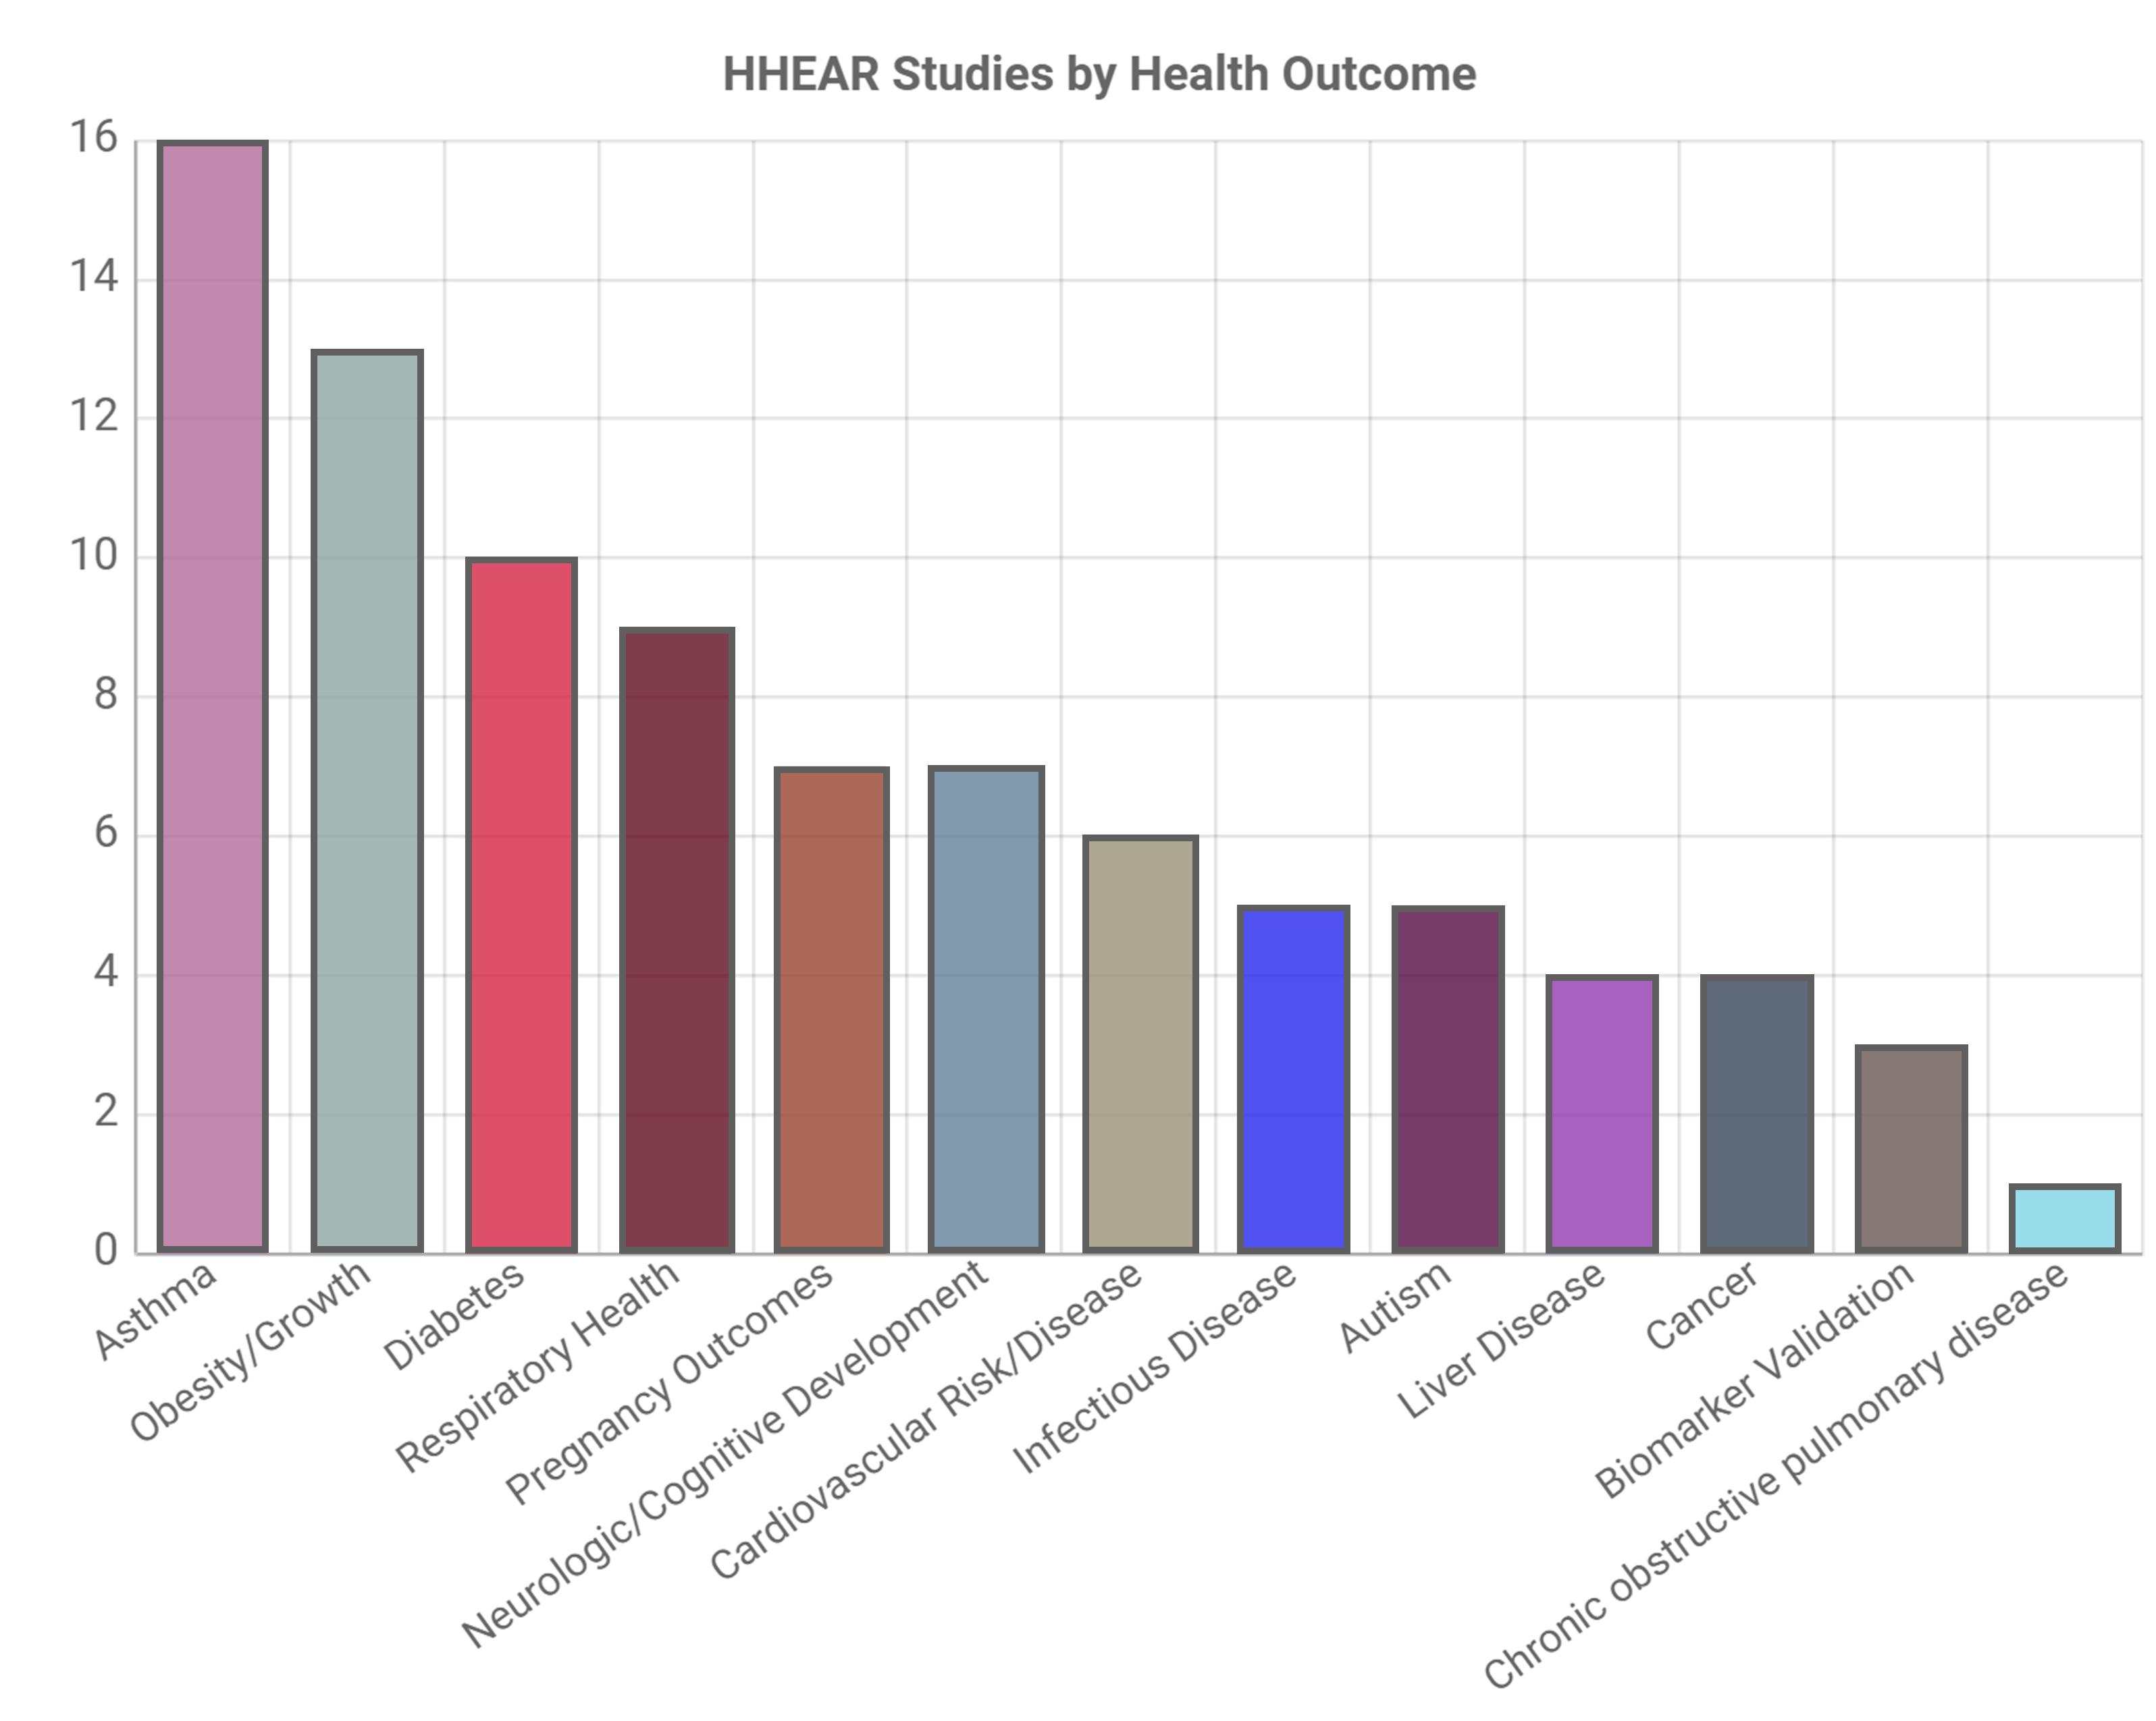
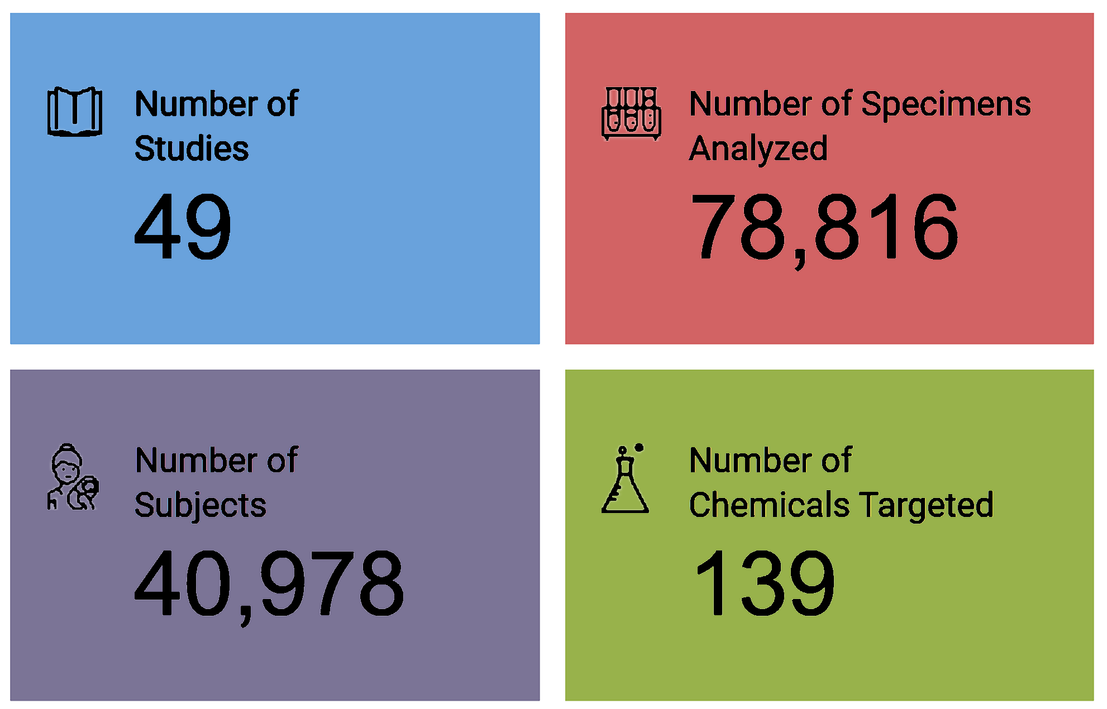
Enhancing Studies (3 of 3)
Opportunity in HHEAR to add to the HHEAR data repository
https://hheardatacenter.mssm.edu/
HHEAR data statistics as of January 2023
Notes:
Additionally, participation in the HHEAR program is an opportunity to add to the HHEAR data repository, which is a valuable harmonized resource.
-The HHEAR Data Center repository holds all data generated by the HHEAR Lab Hubs along with pre-existing epidemiologic data provided by HHEAR study Principal Investigators.
-After an embargo period, the HHEAR Data Center will provide publicly accessible de-identified datasets.
These data include, but are not limited to:
-The environmental exposure biomarkers and environmental exposure data
-Previously collected epidemiologic data such as key covariates, like, sex, race/ethnicity, age, and education
-Previously measured biomarkers (including clinical biomarkers)
-Genetic data and
-Health outcome information
Visit the website for the most up-to-date data from HHEAR studies.
https://hheardatacenter.mssm.edu/

Slide 26
HHEAR Services
HHEAR provides services for analysis of human and environmental samples from human health studies to measure environmental exposures.
These include
Expert consultations
State-of-the-art laboratory analysis
Statistical analysis, data integration, and interpretation
A repository of de-identified epidemiologic and biomarker data
Contact the HHEAR Coordinating Center at HHEARHelp@westat.com to request a pre-submission consultation
Notes:
If you are interested in learning more about how your study samples could be assessed for environmental exposures, HHEAR has several resources to help!
HHEAR provides consultative services that you can take advantage of in the early stages of developing a proposal. In addition to expert consultations, HHEAR offers lab and statistical analysis support.
HHEAR even has special techniques to look at longitudinal data. And again, HHEAR has a growing repository of epidemiologic and biomarker data
Contact the HHEAR coordinating center at HHEARHelp@westat.com to request a pre-submission consultation.
During this meeting you will be connected with scientists from the HHEAR Lab Hubs or Data Center to address your inquiries

Slide 27
Additional Resources
See how to apply, eligibility, and additional information:
hhearprogram.org
HHEAR YouTube channel (Education Modules & Investigator Presentations):
https://www.youtube.com/@humanhealthexposureanalysi9353/featured
NIEHS YouTube channel:
Featuring the exposome: https://www.youtube.com/watch?v=dVPDpFaHyGc
What is the exposome and exposomics?
https://hhearprogram.org/what-exposome-and-exposomics
Untargeted Analysis of Biospecimens
https://hhearprogram.org/untargeted-analysis-biospecimens
CERCH UC Berkeley
https://cerch.berkeley.edu/resources/environmental-exposures
EPA Exposure Assessment Tools by Routes
https://www.epa.gov/expobox/exposure-assessment-tools-routes
HHEAR Data Repository
https://hheardatacenter.mssm.edu/
Factors affecting susceptibility
https://www.epa.gov/expobox/exposure-assessment-tools-lifestages-and-populations-highly-exposed-or-other-susceptible
Notes:
We have provided a list of links to additional environmental exposure resources. We hope you found this module useful.

