Slide 1
Navigating HHEAR Post-Approval
An Overview
Notes:
Welcome to the HHEAR education module “Navigating HHEAR Post-Approval” … An Overview

Slide 2

You’ve made it through steps 1 - 7…
1.
Create myHHEAR Account
3.
Initial Assessment
5.
Submit
online Final Application
7.
Final Decision
2.
Submit
online Initial Application
4.
Consultation & Feasibility Assessment
6.
Scientific
Expert Panel Review
…and your application was approved!!
Congratulations!!!
Notes:
You’ve made it through the application process, feasibility review, scientific expert panel review… and your application was approved. Congratulations!

Slide 3
…so, what’s next…
Notes:
So what comes next? You’ve done a lot of work so far, now it is time to get your project moving!

Slide 4
Navigating HHEAR Post-Approval (1 of 2)
Objectives:
Understand the steps to obtain HHEAR services following the approval of your HHEAR application: The Post-Approval Process.
Be aware of critical deadlines for submitting required documents, “Clearance Activities,” and retrieving, labeling, and shipping samples.
Obtain access to guidance and tools for successfully navigating the post-approval process.
Notes:
The objectives for today are as follows:
First, we want you to Understand the steps to obtain HHEAR services following the approval of your HHEAR application: The Post-Approval Process.
Second, we want you to Be aware of critical deadlines for submitting required documents, “Clearance Activities,” and retrieving, labeling, and shipping samples.
**please note that Some of the early documentation is pre-requisite to subsequent steps… so timely completion of all parts of the process is important to avoiding slowdowns**
And Finally, we want you to understand how to obtain access to guidance and tools for successfully navigating the post-approval process.
… let’s get started…

Slide 5
Navigating HHEAR Post-Approval (2 of 2)
The Steps of the Post-Approval process include:
Notes:
The overall Post-Approval Process has many components as you can see here. In the subsequent slides we will present an overview of key phases of the process. Additional details for each phase will be presented in 4 separate modules.

Slide 6
1. Clearance Activities
Notes:
This slide shows a flow chart for the first phase of the post-approval process: clearance activities. It includes basic deadlines and responsibilities for this phase – this is the focus of the module titled “Navigating HHEAR Post-Approval, Phase 1: Clearance Activities.”
Please note that once your project is approved, you should start working on the IRB Attestation Letter, Data Submission Agreement and Data Sharing Plan, the MTAs, and Lab Analysis Plan RIGHT AWAY…
As you can see there are various deadlines for the different parts of this phase… we will refer back to this flowchart during the Clearance Activities module, but as a preview
The Data Submission Agreement and Data Sharing Plan also known as the DSA and DSP respectively, and IRB Attestation Letter are due 8 weeks post-approval
For the MTA, or materials transfer agreement, submission is required 10-12 weeks post-approval
And the Lab Analysis plans are due no later than 12 weeks post-approval
Completing the documents on time is important because they are pre-requisite to later steps…
After the PI submits the DSA, DSP, and IRB Attestation Letter, the Data Center approves those documents at 9-10 weeks post approval… only after these documents are approved do you gain access to the Data Center Portal which allows you to upload your data (this is denoted by the star in the flow chart)… The PI then submits the data no later than 10-12 weeks post approval and then the DC approves the data at 12-16 weeks post approval.
The Last step of this stage is the DC approving project data.
another version of the flow chart can be found on p. 13 of the Policies for Access to HHEAR Services.

Slide 7
2. Prepare and Ship Samples to Lab Hub
Notes:
This is a flow chart of activities associated with “label and ship samples” phase of the Post-Approval process. As you can see, it begins at approx. 16 weeks post-approval, immediately following the completion of the Clearance Activities Phase. In the “Navigating HHEAR Post-Approval, Phase 2: Labelling & Shipping” Module, we will refer back to this flow chart.
Some important items to note are:
The Coordinating Center, or CC, prints sample labels and ships them to the PI AND facilitates a conference call with PI, all involved Lab Hubs, and CC to discuss sample labeling and shipping…. This occurs by approx. 17-18 weeks post approval.
After the Samples labeling call, the LH will request to PI to label, pack and ship samples.
Over the next several weeks the PI uses DC portal to link SIDs to PIDs and print the shipping manifest. Finally when the PI is ready to ship samples, they will confirm that the LH is ready to receive samples and coordinate a shipping date. Once the shipment has been coordinated, the PI ships samples… this is all done by 24 weeks post-approval.

Slide 8
3. Laboratory and Statistical Analysis
*untargeted/metabolomic results will be uploaded via the Metabolomics Workbench.
Notes:
This is a flow chart for the Lab and Statistical Analysis Phase, the third phase of the Post-Approval Process. Note that in this flow chart the dates are given in MONTHS AFTER THE PREVIOUS ACTION.
While, like the previously displayed flowcharts, this will be discussed in detail in the module dedicated to this phase, Laboratory and Statistical Analysis, there are few things we’d like to point out as a preview.
Once the LH receives the samples, analysis will take approximately 6-9 months depending on the number and complexity of the analyses, AND the queue of the LH. Your project’s progress can be tracked from your myHHEAR dashboard.
Once the Analyses are complete the DC will review the results and do quality control before releasing the final data files to the PI – this takes about 1-2 months. After that, if statistical analysis was requested, the DC will work with the PI to complete this portion of the project – this takes an additional 6-9 months.
Please note that untargeted/metabolomic results will be made available through the Metabolomics Workbench, which is linked at the bottom of this screen. Please note that all active links in this module and all other post approval modules are available in the slides on the HHEAR website.

Slide 9
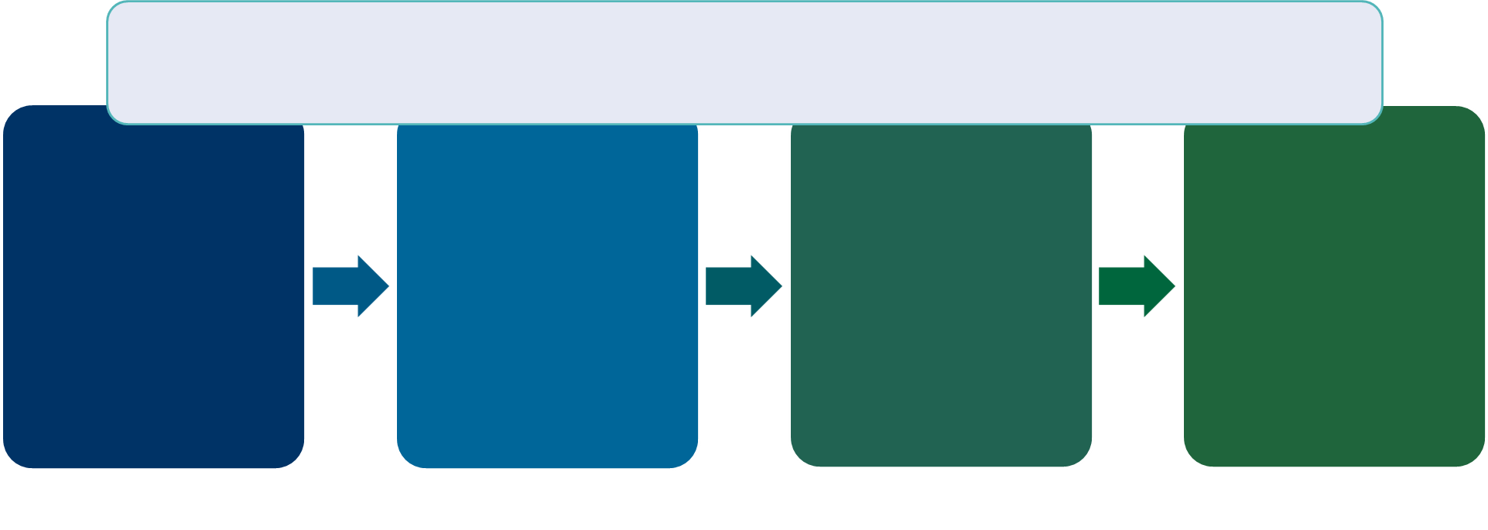
4. Publish Results
After receiving your results or completing the statistical analysis, your data will remain in embargo for 1-year or until you publish your results (whichever occurs first)
Step 1.
Ready to prepare your manuscript!
Step 2.
Determine Authorship
Step 3.
Acknowledge NIH and others
Step 4.
Register Manuscript with HHEAR
Notes:
This chart highlights the critical components of the final phase of the post-approval process – PUBLICATION. This process will be covered in depth in the Publication module… but as a preview, we’d like to highlight a few things:
First… Your results will remain in embargo for 1 year from the time you received results or completed the statistical analysis with HHEAR - OR until you publish your results – whichever occurs first.
While working on your manuscript, there are several important considerations you must keep in mind (again these are covered in depth in the publication modules and in the policy guide for publication)… they include:
Determining authorship (and being sure to include the appropriate contributors from HHEAR components)
… and Acknowledging NIH funding as well as other contributions as appropriate
And finally, once the manuscript is complete, it must be registered with HHEAR

Slide 10
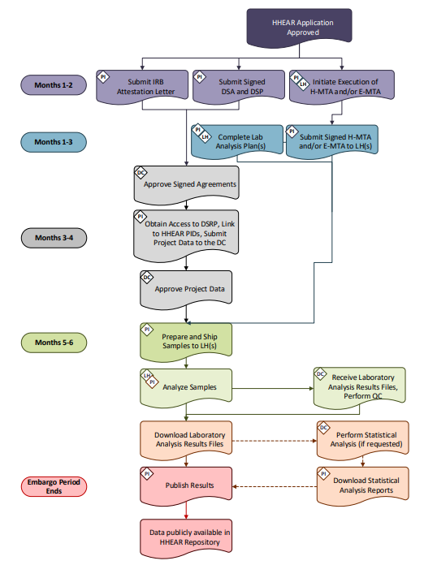
Reminders (1 of 2)
There are many steps involved in moving your project from an approved application to publication…
Being aware of (and adhering to) the timeline helps facilitate the successful completion of your project.
Notes:
Remember There are many steps involved in moving your project from an approved application to publication… AND there are Many people involved.
Being aware of (and adhering to) the timeline helps facilitate the successful completion of your project.

Slide 11
Reminders (2 of 2)
The Coordinating Center will contact you and provide step-by-step instructions. Please respond promptly to requests for information.
The Lab Hub(s) and Data Center will reach out to you for information as needed, please be sure to respond promptly to requests for information.
Excessive delays or missing documents can jeopardize access to services.
If you have questions or concerns, reach out to the HHEAR Coordinating Center at HHEAR_CC@westat.com.
Notes:
Here are a few reminders:
The coordinating Center will contact you and provide step-by-step instructions. Please respond promptly to requests for information.
The Lab Hub(s) and Data Center will reach out to you for information as needed, please be sure to respond promptly to requests for information
Please remember that excessive delays or missing documents can jeopardize access to services
If you have questions or concerns, please remember that you can always reach out to the HHEAR Coordinating Center at HHEAR_CC@westat.com for assistance!

Slide 12
FAQs
Additional Questions?
Review the FAQs section of the HHEAR Public Website.
Contact the HHEAR Coordinating Center at HHEAR_CC@westat.com.
Notes:
If you have Additional Questions:
Review the FAQs section of the HHEAR Public Website.
And/or
Contact the HHEAR Coordinating Center at HHEAR_CC@westat.com.

Slide 13
Resources
Refer to the following webpages for more information:
  How to Apply
    https://hhearprogram.org/how-apply
  Policies
    https://hhearprogram.org/policies
  Support Documents
    https://hhearprogram.org/support-docs
  FAQs
    https://hhearprogram.org/faqs
  Data Repository
    https://hheardatacenter.mssm.edu
Notes:
And finally, here we have provided links to portions of the HHEAR website and data repository that you might find helpful.

