Slide 1

Navigating HHEAR Post-Approval
Phase 3: Analyses & Results
Notes:
Welcome to the education module “Navigating HHEAR Post-Approval” … phase 3… Analyses & Results

Slide 2
Navigating HHEAR Post-Approval (1 of 3)
The Steps of the Post-Approval process include:
This module will focus on this step
Notes:
As reviewed in the Post-Approval Overview, there are four main phases of the Post-Approval process. In this module we will dig into the details of the third phase: Laboratory & Statistical Analyses… and results.

Slide 3
Navigating HHEAR Post-Approval (2 of 3)
Objectives:
Understand the steps involved in obtaining the results of laboratory and data analyses.
Obtain access to guidance and tools for successfully navigating the post-approval process.
Notes:
The objectives for today are as follows:
First, we want you to understand the steps involved in obtaining the results of HHEAR services.
Second, you should understand how to Obtain access to guidance and tools for successfully navigating the post-approval process.
… let’s get started…

Slide 4
Navigating HHEAR Post-Approval (3 of 3)
*untargeted/metabolomic results will be uploaded via the Metabolomics Workbench.
Notes:
You may recall this flow chart from the Post-Approval Process overview. The process in this chart picks up after samples have been shipped to the lab hub(s). Please note that the time frames given in this phase will be in months after the completion of the previous step. Overall, once the labs receive samples, it typically takes 6-9 months for lab analyses to be complete and the results to be sent to the data center. Once the data center has the results it then takes 1-2 months for the quality control process and the results to be made available to investigators. If statistical analysis has been requested it takes another 6-9 months after the PI received their data. We will anchor back to this through out the module...
Now let’s get into the details.

Slide 5




Laboratory & Statistical Analysis (1 of 4)
# of samples
# of analyses
Projects in lab queue
Samples Arrive @ Lab
Notes:
Once the Labs receive the samples, they will begin the analysis. PLEASE NOTE: The time to complete the laboratory analyses is dependent on several factors, such as types of analyses, number of samples, and projects already in the analysis queue. The 6-9 month time frame is an estimate but will vary dependent upon the factors just mentioned.
When the Lab Hub(s) complete the requested analyses, they submit results data to the Data Center.

Slide 6
Laboratory & Statistical Analysis (2 of 4)
Note: untargeted profiling data is provided through Metabolomics Workbench.
Notes:
HHEAR’s work doesn’t end there. Once the Lab Hub(s) complete the requested analyses and the results have been submitted to the Data Center. The Data Center reviews the data files and works with the Lab Hub(s) to resolve any issues.
The Data Center will then notify you that you are able to download the lab results data and summary reports from the Data Center Portal. This is estimated to take 1-2 months.
If you have requested untargeted profiling data, these will be provided through Metabolomics Workbench.

Slide 7
Laboratory & Statistical Analysis (3 of 4)
Track your Project’s Status
Your project’s status can be viewed on your myHHEAR dashboard under “Other Project Tasks.”
Here you will see:
  Analyses initiated
  Analyses completed
  Which results have been transferred to the Data Center
  Status of the Data Center Quality control review
  Relevant comments about the analyses
Notes:
Tracking you Project’s status…
You are able to Track your Project’s Status on your myHHEAR dashboard under “Other Project Tasks.”
Here you will see:
Analyses initiated
Analyses completed
Which results have been transferred to the Data Center
Status of the Data Center Quality control review
Relevant comments about the analyses
Again, please note that if you have requested untargeted profiling data, these will be provided through Metabolomics Workbench.

Slide 8
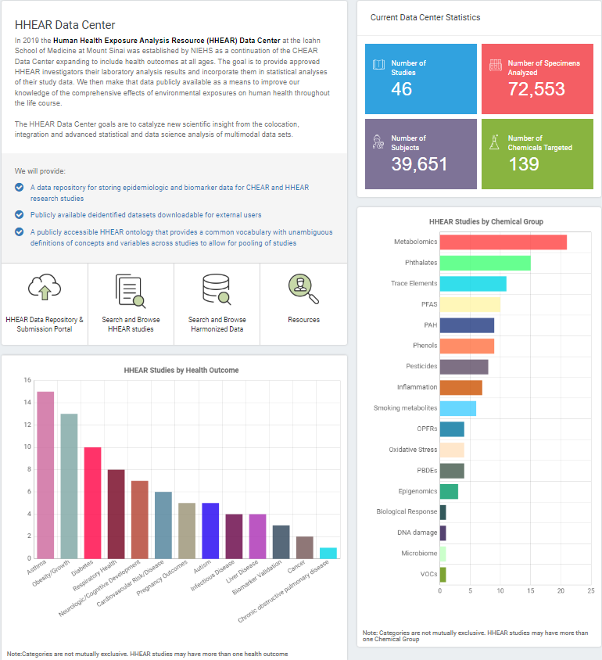
Laboratory & Statistical Analysis (4 of 4)
Once you have received the lab results, you will work with the Data Center as needed to conduct the statistical analysis
The Data Center will deposit the final project data files and results in the data repository.
Notes:
Once you have received the lab results, If the Data Center is providing statistical analysis services, they will work with you to conduct the analyses and produce reports that enable you to achieve the aims of your HHEAR project.
The Data Center will notify you when the final statistical results files for your project are available on the Data Center Portal… at this point they will also deposit the data and results in the data repository.

Slide 9
Reminders
There are many factors that impact how long the laboratory analysis takes, including the number of specimens, the number & complexity of analysis, and the queue of the lab hub.
Please be sure to respond to all HHEAR team communications promptly.
Untargeted data is provided through the Metabolomics Workbench at https://www.metabolomicsworkbench.org/
The data center has many resources that you might find useful during your post-approval process. They can be accessed at https://hheardatacenter.mssm.edu/Resource/Get
Notes:
We have a few key reminders related to this process:
First, There are many factors that impact how long the laboratory analysis takes, including the number of specimens, the number & complexity of analysis, and the queue of the lab hub.
Second, Please be sure to respond to all HHEAR team communications promptly.
Third, Untargeted data is provided through the Metabolomics Workbench at https://www.metabolomicsworkbench.org/
Finally, The data center has many resources that you might find useful during your post-approval process. They can be accessed at https://hheardatacenter.mssm.edu/Resource/Get

Slide 10
Resources
Refer to the following webpages for more information:
  How to Apply
    https://hhearprogram.org/how-apply
  Policies
    https://hhearprogram.org/policies
  Support Documents
    https://hhearprogram.org/support-docs
  FAQs
    https://hhearprogram.org/faqs
  Data Center Portal & Data Repository
    https://hheardatacenter.mssm.edu/
Notes:
As a reminder there is additional information available on the HHEAR website such as How to Apply, Policies, Support Documents, and FAQ, as well as a link to the data center portal and data repository… each of which is also linked on this slide.
Good luck and remember we are here to help!

