Slide 1
Navigating HHEAR Post-Approval
Part 4: Publication

Slide 2
Navigating HHEAR Post-Approval (1 of 2)
The Steps of the Post-Approval process include:
This module will focus on this step
Notes:
As reviewed in the Post-Approval Overview, there are four main phases of the Post-Approval process. In this module we will dig into the details of the fourth and final phase: Publication

Slide 3
Navigating HHEAR Post-Approval (2 of 2)
Objectives:
Understand the steps to publishing the results from HHEAR analyses.
Be aware of critical deadlines along the way (such as the embargo period)
Obtain access to guidance and tools for successfully navigating the publication process.
Notes:
The objectives for today are as follows:
First, we want you to Understand the steps to publishing the results from HHEAR analyses.
Second, we want you to be aware of critical deadlines along the way… such as the embargo period.
And Finally, you should understand how to Obtain access to guidance and tools for successfully navigating the post-approval process to PUBLISH your results!!
… let’s get started…

Slide 4
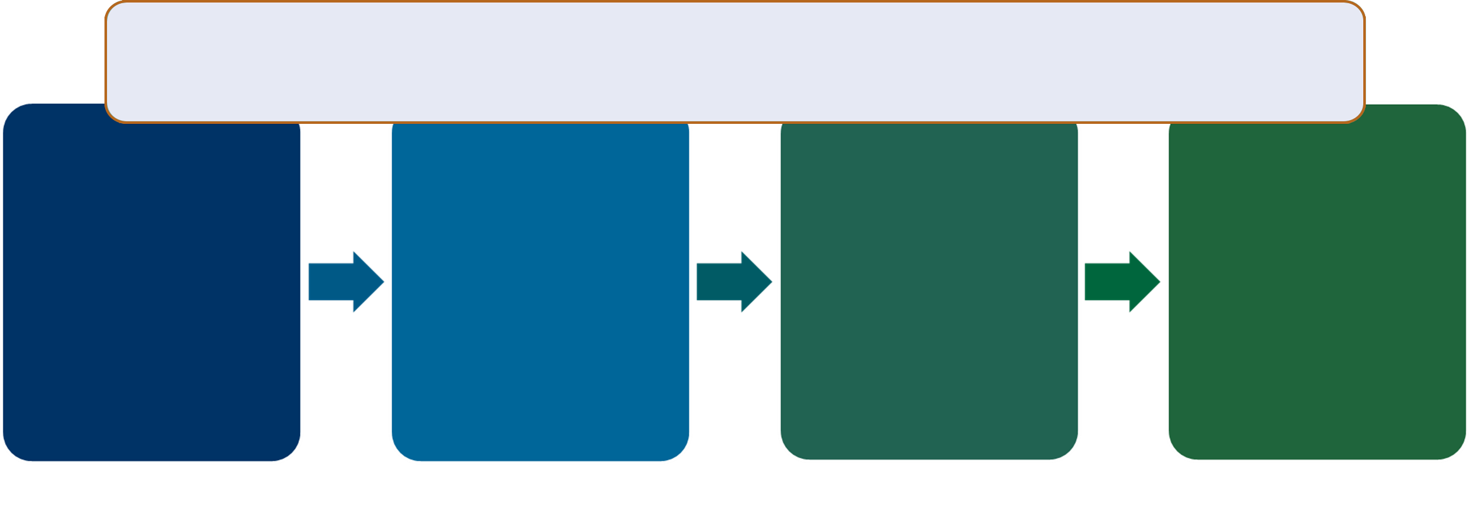

Steps for Publication
After receiving your results or completing the statistical analysis, your data will remain in embargo for 1-year or until you publish your results (whichever occurs first)
Ready to prepare your manuscript!
Determine Authorship
Acknowledge NIH and others
Register Manuscript with HHEAR
Tip
Check the HHEAR Publications Policy on HHEARProgram.org for more information.
Notes:
As in the previous post approval stages, we’ll start by looking back to the flowchart that you originally saw in the overview video. This provides a high-level overview of what we will talk about in this module.
Recall that After receiving your results or completing the statistical analysis, your data will remain in embargo for 1-year or until you publish your results (whichever occurs first).
When working toward publishing you will need to determine authorship and acknowledge the contributions/funding of NIH and others. Once the manuscript is ready for submission (and has been approved by all authors), the manuscript must be registered with HHEAR.
Let’s look a little more deeply…

Slide 5
Publication – Determining Authorship (1 of 2)
It is expected that researchers in the HHEAR Laboratory Hub(s) and Data Center will be sufficiently involved in the experimental design, sample processing, analysis, and interpretation of data to justify co-authorship on most manuscripts generated through this process
**The respective HHEAR Laboratory Hub(s) and HHEAR Data Center will identify the individuals from their respective institutions that should receive authorship credit for their contributions.**
All authors should give final approval of the version to be published and take responsibility for its content.
Notes:
Determining Authorship is a critical component of publishing…
It is expected that researchers in the HHEAR Laboratory Hub(s) and Data Center will be sufficiently involved in the experimental design, sample processing, analysis, and interpretation of data to justify co-authorship on most manuscripts generated through this process
**The respective HHEAR Laboratory Hub(s) and HHEAR Data Center will identify the individuals from their respective institutions that should receive authorship credit for their contributions.**
All authors should give final approval of the version to be published and take responsibility for its content.

Slide 6
Publication – Determining Authorship (2 of 2)
Early discussion of authorship between the collaborators is required.
Collaborators, including investigators obtaining HHEAR laboratory and data analysis services and HHEAR Lab Hub and Data Center researchers, will be responsible for determining who meets the criteria for co-authorship.
Potential conflicts of interest, as well as any other publication requirements from collaborators as part of consortia participation should be disclosed at this time
The order of authorship should be agreed to by all authors.
Authorship should be reviewed again when beginning to write the manuscripts.
In the event there is disagreement on authorship, NIH staff will serve as a neutral third-party arbitrator.
Notes:
Early discussion of authorship between the collaborators is required.
Collaborators, including investigators obtaining HHEAR laboratory and data analysis services and HHEAR Lab Hub and Data Center researchers, will be responsible for determining who meets the criteria for co-authorship.
Potential conflicts of interest, as well as any other publication requirements from collaborators as part of consortia participation should be disclosed at this time
The order of authorship should be agreed to by all authors.
Authorship should be reviewed again when initiating the writing of manuscripts and a written record of this understanding should be distributed to the collaborators.
In the event there is disagreement on authorship, NIH staff will serve as a neutral third-party arbitrator.

Slide 7
Publication – Acknowledgments
At an appropriate place in the manuscript (per the journal’s requirement), abstract, poster, or presentation, one or more statements should specify financial acknowledgement as follows:
"Research reported in this publication was supported by the National Institutes of Health under award number [xxxx]. The content is solely the responsibility of the authors and does not necessarily represent the official views of the National Institutes of Health.”
In addition to financial acknowledgement, statements can be included that recognize technical support or other contributions received from HHEAR researchers that do not meet the criteria for authorship.
Notes:
Acknowledgements are another important step on your road to publishing…
At an appropriate place in the manuscript (per the journal’s requirement), abstract, poster, or presentation, one or more statements should specify financial acknowledgement as follows:
"Research reported in this publication was supported by the National Institutes of Health under award number [xxxx]. The content is solely the responsibility of the authors and does not necessarily represent the official views of the National Institutes of Health.”
In addition to financial acknowledgement, statements can be included that recognize technical support or other contributions received from HHEAR researchers that do not meet the criteria for authorship.

Slide 8
Publication – Manuscript Registration
Once a manuscript is ready for submission and has been approved by all named authors, the manuscript must be registered with HHEAR.
This information will only be used for tracking purposes and will not be released to the general public
Notes:
Once a manuscript is ready for submission and has been approved by all named authors, the manuscript must be registered with HHEAR.
This information will only be used for tracking purposes and will not be released to the general public

Slide 9
Publication – Data Embargo (1 of 2)
Data Embargo Period
The data embargo period is a time period during which project data and laboratory results data submitted to the Data Center for an approved project remain unavailable to the public.
This is also true of data deposited in the Metabolomics Workbench
All de-identified data from your HHEAR project (both epidemiologic data and lab results) are made available to the public in the HHEAR Data Repository following the data embargo period.
Notes:
You’ve heard us mention that Your project data will be subject to an embargo period. You might be wondering, what does this mean…
The data embargo period is a time period during which project data and laboratory results that have been submitted to the Data Center for an approved project remain unavailable to the public.
Note this is also true for data deposited to the Metabolomics Workbench.
All de-identified data from your HHEAR project (both epidemiologic data and lab results) are made available to the public in the HHEAR Data Repository following the data embargo period.

Slide 10
Publication – Data Embargo (2 of 2)
The data embargo period lasts 1 year from the later of either:
The date that the final laboratory results data set has been made available to the HHEAR investigator.
The date that the Data Center returns the first finalized statistical analysis report addressing a minimum of one of the project’s specific aims.
If a manuscript using the HHEAR generated laboratory results data is accepted for publication prior to the end of the defined embargo period, the embargo period will end and all de-identified HHEAR project-related data (both epidemiologic/phenotypic data and lab results) will be made publicly available.
Tips
For more information about the HHEAR data embargo period, refer to the HHEAR Policies for Access to Services on the HHEAR website.
Notes:
So how long does the embargo period last???
The data embargo period lasts 1 year from either
The date that the final laboratory results dataset has been made available to the HHEAR investigator
OR the date that the Data Center returns the first finalized statistical analysis report addressing a minimum of one of the project’s specific aims
Whichever occurs last
If a manuscript using the HHEAR generated laboratory results data is accepted for publication prior to the end of the defined embargo period, the embargo period will end and all de-identified HHEAR project-related data (both epidemiologic/phenotypic data and lab results) will be made publicly available.
For more information about the HHEAR data embargo period, refer to the HHEAR Policies for Access to Services, available on the HHEAR website.

Slide 11
Publication
Tips
The HHEAR Publications Policy document contains verbiage that can be used when acknowledging HHEAR resources.
If you have questions about the publication policies reach out to the coordinating center at HHEAR_CC@westat.com
Notes:
Some tips to keep in mind are:
The HHEAR Publications Policy document contains verbiage that can be used when acknowledging HHEAR resources.
And…
If you have questions about the publication policies reach out to the coordinating center at HHEAR_CC@westat.com

Slide 12
Reminders
The publications policy document can be found on the HHEAR website and is linked here (HHEAR Publications Policy).
Section 3.3.5 of the HHEAR Policies for Access to Services document includes the details of the Embargo Period.
The HHEAR Lab Hub and Data Center researchers, will be responsible for determining who meets the criteria for co-authorship.
NIH funding should be acknowledged where appropriate.
Notes:
Additionally, please remember that…
The publications policy document can be found on the HHEAR website and is linked here. Note that this and all other links in this module are available as active links in the powerpoint available on the HHEAR website.
Section 3.3.5 of the HHEAR Policies for Access to Services document includes the details of the Embargo Period.
The HHEAR Lab Hub and Data Center researchers, will be responsible for determining who meets the criteria for co-authorship.
NIH funding should be acknowledged where appropriate.

Slide 13
Resources
Refer to the following webpages for more information:
How to Apply
https://hhearprogram.org/how-apply
Policies
https://hhearprogram.org/policies
Support Documents
https://hhearprogram.org/support-docs
FAQs
https://hhearprogram.org/faqs
Data Center Portal & Data Repository
https://hheardatacenter.mssm.edu
Notes:
As a reminder there is additional information available on the HHEAR website such as How to Apply, Policies, Support Documents, and FAQs, as well as a link to the data center portal and data repository… each of which is also linked on this slide.
Good luck and remember we are here to help!

