Slide 1

Considerations for a High-Quality HHEAR Application
1.
Create myHHEAR Account
3.
Initial Assessment
5.
Submit online Final Application
7.
Final Decision
2.
Submit online Initial Application
4.
Consultation and Feasibility Assessment
6.
Scientific Expert Panel Review
Notes:
Hello and welcome to the education module “Considerations for a High-Quality HHEAR Application.” <<<for the Human Health Exposure Analysis Resource program, otherwise known as HHEAR.>>> This module is focused on critical parts involved in step 2 of the overall application process – submitting your ONLINE initial application. A high-quality, clearly-written application can facilitate a smoother process through the subsequent steps.

Slide 2
Objectives
Learn about the critical components of a high-quality application
Learn how to avoid some of the common application pitfalls
Learn how to access additional resources to help you through the application process
Excerpt from HHEAR Example Application: https://hhearprogram.org/sites/default/files/HHEAR-SampleApplication-508.pdf
Notes:
Our objectives today are as follows:
To learn about the critical components of a high-quality application.
To learn how to avoid some of the common application pitfalls.
To learn how to access additional resources to help you through the application process.
This module is designed to help guide you to a successful application and to make the process as smooth as possible.
On the right side of the slide, you will see an excerpt from the Annotated Example Application, a resource that is posted on the HHEAR website. You will see excerpts from the example application occasionally as we go through the content of this module. As you complete the application this is an additional resource that you might find helpful.

Slide 3


HHEAR Program Goals
Advance understanding of the impact of environmental exposures on human health throughout the life course.
Promote characterization of the totality of human environmental exposures called the exposome.
Notes:
Before we dive into the actual components of the application, let’s review the HHEAR program goals. You will want to keep these in mind as you complete your application as alignment to the programmatic goals is an important part of the application.
The first goal is to “Advance understanding of the impact of environmental exposures on human health throughout the life course.”
The second goal is to “Promote characterization of the totality of human environmental exposures called the exposome.” Again, these goals should be an underpinning to your proposed HHEAR project.

Slide 4
Overview of Types of Studies HHEAR Supports
HHEAR provides services for analysis of human and environmental samples from human health studies to measure environmental exposures.
The program places a priority on HHEAR applications that have a focus on either discovery (untargeted analyses of the exposome) or hypothesis-driven (targeted analyses) research with adequate power to address the specific aims.
Pilot-scale studies are not appropriate for HHEAR.
Notes:
You’ll want to ensure the proposed study you submit falls within the realm of the types of studies HHEAR supports. HHEAR provides services for the analysis of human and environmental samples from human health studies measuring environmental exposures.
Priority is placed on applications with a focus on discovery, that is untargeted analyses of the exposome, or hypothesis-driven research (utilizing targeted analyses) with adequate power to address the indicated aims of the study.
Pilot scale studies are not appropriate for HHEAR services.

Slide 5

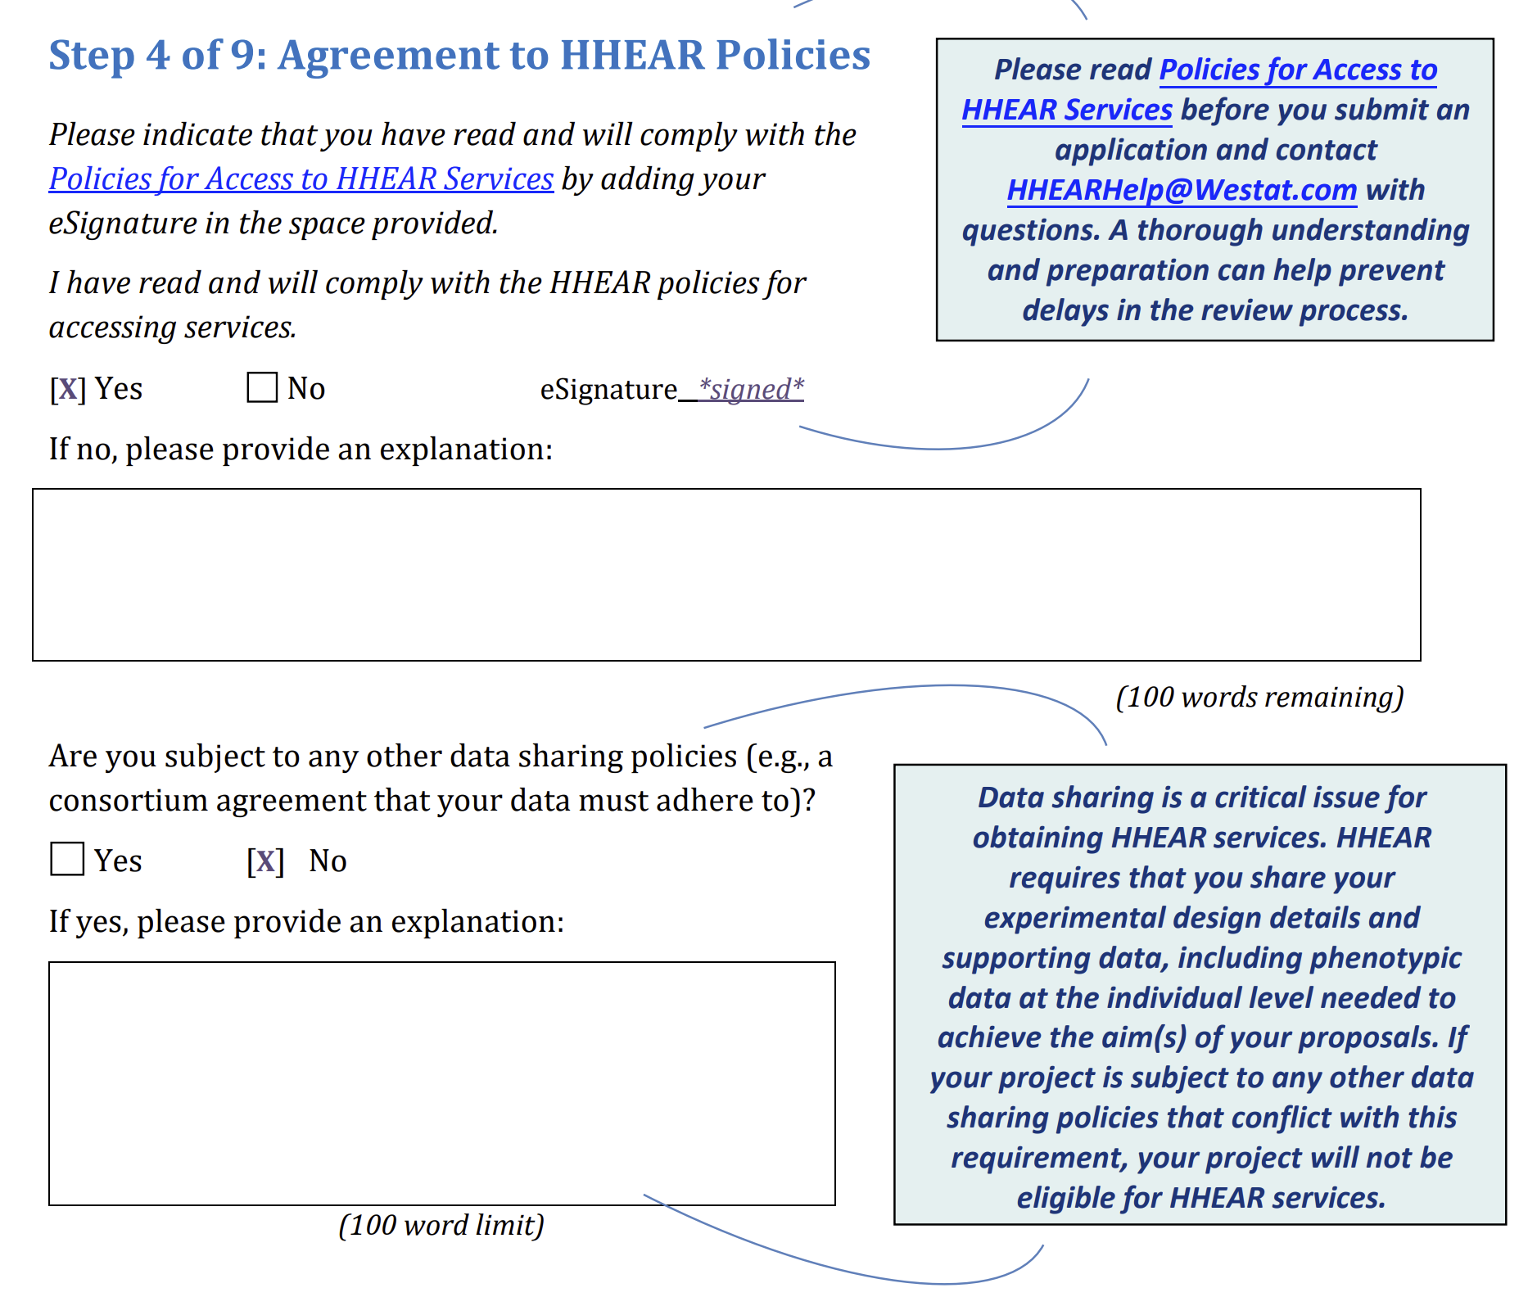
Prepare for Success
Tips: Be fully informed! Go to HHEARProgram.org. Read the information in the “How to Apply” section to answer these questions:
Have you checked on the availability of the samples you want to submit for analysis?
Does the informed consent form for your parent project allow use of data and samples for unspecified future research and public sharing of de-identified data?
Does the data sharing policy for your parent project conflict with HHEAR data sharing policies?
Can you comply with the HHEAR application review and post-approval deadlines?
Excerpt from HHEAR Example Application: https://hhearprogram.org/sites/default/files/HHEAR-SampleApplication-508.pdf
If you need assistance on how to interpret HHEAR policies for your application, contact the HHEAR coordinating center at HHEARHelp@westat.com for support.
Notes:
Inadequate preparation before you submit an application can result in lengthy delays during the review process or even stop a project after it is approved. This slide provides tips on how to be fully informed before you start the HHEAR application process.
The “How to Apply” section of the HHEAR public website, HHEARProgram.org, provides information critical to the application and post-approval processes, including a description of HHEAR research priorities, eligibility criteria, and HHEAR Policies for Access to Services.
Please be sure to read this information to avoid major pitfalls of the application and post-approval processes.
Some critical tips include:
Check on the availability of the samples you want to submit for analysis before you submit an application. Check the database and make a physical check of the samples in their storage locations.
Make sure you can comply with HHEAR data submission and data sharing policies. Review the informed consent forms and the data sharing policies for your parent study. Talk with your IRB and the person or persons with the authority to commit to submission and sharing of project data. Confirm that there are no barriers to submission and public sharing of all individual level, de-identified project data required to address your project aims.
Review the schedule and deadlines for the application and post-approval processes. HHEAR cannot guarantee services for projects with excessive delays.
If you have questions or concerns about how to interpret HHEAR policies for your application, please reach out to the coordinating center at HHEARHelp@westat.com, <<that’s H H E A R Help@westat.com,>>> for support.
Also, please note that the links on this slide and all other slides during this presentation can be accessed via the links in this PowerPoint which is available on the HHEAR website.

Slide 6
Elements of a Successful HHEAR Application
High quality applications will include the following…
1. An explanation of the significance of the project
2. Accurate information regarding study design, participants, and samples
3. A justification for each requested lab analysis
4. A statistical analysis approach and power calculations for each aim
Notes:
With all of that in mind, today we will focus on four key elements of a high-quality application.
First, an explanation of the significance and alignment of the project to HHEAR goals.
Second, inclusion of accurate information regarding study design, participants, and samples.
Third, a scientific justification or rationale for EACH requested lab analysis.
… And fourth, a statistical analysis overview with power calculations for each aim.
In the following sections we will cover each of these more in-depth.

Slide 7
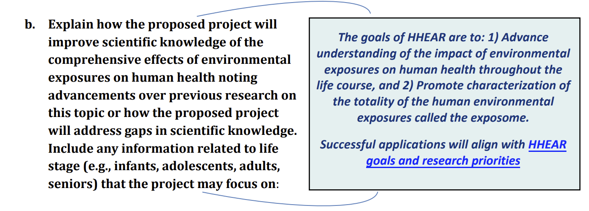
1. Significance (1 of 2)
A successful application will clearly demonstrate that the proposed study…
is consistent with HHEAR research priorities
adds or expands environmental exposure analyses for the parent study
advances the understanding of the role of environmental exposures in human health
Notes:
Let’s begin with significance. A successful application will clearly demonstrate that the proposed study is consistent with HHEAR research priorities, it adds or expands environmental exposure analyses for the parent study, and it advances the understanding of the role of environmental exposures in human health. So, what does this mean…
Your application should communicate what you want to accomplish, how it will be accomplished, and why it is important to the broader scientific community.

Slide 8
1. Significance (2 of 2)
Tips
Describe the strengths and weaknesses of the data and previously performed work upon which the proposal is based. Provide citations to support your premise.
Clearly describe exposures, primary health outcomes, and any secondary outcomes for each of your specific aims.
Provide a justification for the proposed number of participants to be included for each aim.
Provide a scientific rationale for each requested lab analysis. Explain how you will use the lab analysis results to assess the relationship between the exposure and health outcome for each specific aim.
If you need assistance with this aspect of your application, contact the HHEAR coordinating center at HHEARHelp@westat.com for support.
Notes:
We have a few tips for what you should include to successfully describe the scientific premise and significance of your proposed project.
Begin with a description of the strengths and weaknesses of previously performed work which is the basis of your proposal. Provide citations to support your premise.
Clearly identify exposure(s), primary health outcome and any secondary outcomes for each of your study aims.
Provide a justification for the proposed number of participants to be included for each aim and a scientific rationale for each requested lab analysis. Explain how the lab analysis results can be used to assess the relationship between the exposure and the health outcome for each specific aim.
If you need assistance with this, or any aspect of your application, contact the HHEAR coordinating center for support.

Slide 9
2. Study Design, Participants, & Samples (1 of 3)
Clarity, accuracy and sufficient detail are key!
For the parent study – provide sufficient detail about study population, design, exposures, outcome and covariate data and sample collection to inform understanding and evaluation of the proposed HHEAR project
For the proposed HHEAR project – provide information on study design, participants, samples, exposures and outcomes for each specific aim
Notes:
The second element of the application we would like to discuss is …“Study design, participants, and samples.”
A common pitfall for completion of an application is ambiguous and inaccurate information about study design, study population, and biological and/or environmental samples for both the parent study and the proposed HHEAR project.
There is space in the application to provide information on all critical details.
For the parent study, a successful application will include sufficient information about the parent study population, design, data, and sample collection to accurately inform understanding of your proposed HHEAR project.
For the proposed HHEAR project, a successful application will include a clear description of the study design and accurate information about the participants, samples, exposure analyses, and outcome data to be included for each specific aim.
As you complete each section for your HHEAR project application, you should be providing the requested information with an explanation of its importance for each of your specific aims.

Slide 10
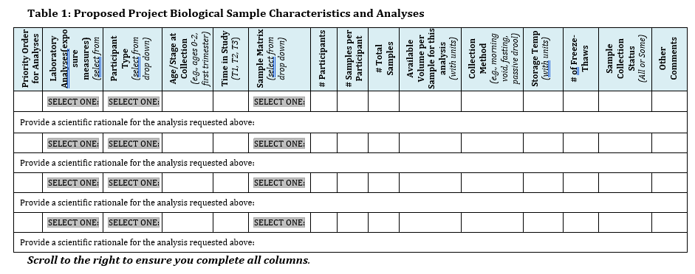
2. Study Design, Participants, & Samples (2 of 3)
Tips
Questions about the suitability of your biological samples or exposure analyses? Contact the HHEAR Coordinating Center to schedule a pre-submission consultation with HHEAR Lab Hub scientists. (HHEARHelp@westat.com)
Check information on preferred sample volume/mass for each HHEAR lab analysis. See the HHEAR Available Analyses by Sample Matrix (http://hhearprogram.org/sample-matrix-table)
Be thorough!
Immediately following the table, provide detailed information for each type of biological sample - collection, processing and storage – methods, containers, and additives.
Notes:
We’d like to take a moment to draw your attention to an important table in your application. The purpose of this table is to provide information on the characteristics of participants and the associated biological samples that will be included for each of your requested laboratory analyses and to provide a justification for how each analysis can be used to assess the relationship between the exposure and health outcomes.
We have a couple of specific tips to keep in mind while completing this table.
First - If you have questions about which exposure analyses are appropriate for your study population and health outcomes, we strongly recommend you contact the HHEAR Coordinating Center at HHEARHelp@westat.com to schedule a pre-submission consultation. During this type of consultation, scientists from HHEAR Lab Hubs will discuss your study aims and respond to questions about your study design, available biological samples, and options for exposure analyses.
Second - If you have questions about the suitability of your samples for a HHEAR lab analysis, you can find information on the preferred sample type and volume or mass for each HHEAR lab analysis in the HHEAR Available Analyses by Sample Matrix table on HHEARProgram.org.
Third - Be specific about how many samples you will be submitting for analysis. If you have participants with samples at multiple time points in the study, complete a separate row for each time point. If you have participants with multiple types of samples, complete a separate row for each type of sample.
Fourth - Take the time to confirm the accuracy of your information.
Finally, please note that immediately following the table, there is an item requesting information for each type of biological sample to be analyzed for your project. Be thorough in your description. This information is critical to the evaluation of the feasibility of your HHEAR project.

Slide 11
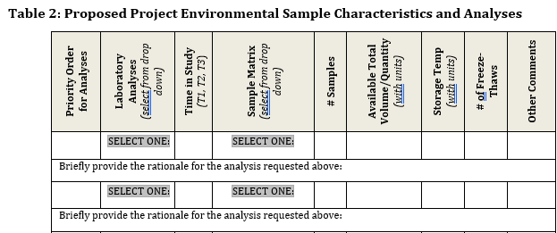
2. Study Design, Participants, & Samples (3 of 3)
For environmental samples you will complete a chart similar to the one completed for biological samples.
Tips
Consult HHEAR Lab Hub scientists to discuss proposed analyses and sample collection, processing, and storing requirements before submitting an application.
Contact the HHEAR coordinating center at HHEARHelp@westat.com to schedule a pre-submission consultation.
The environmental samples chart shown here is located on page 16 of the application.
Notes:
For environmental samples you will complete a chart similar to the one completed for biological samples. The environmental samples chart can be seen in the right side of this slide and is on page 16 of the application.
For analysis of environmental samples, investigators are strongly encouraged to consult HHEAR Lab Hub scientists to discuss proposed analyses and sample collection, processing, and storage requirements before submitting an application. Contact the HHEAR coordinating center at HHEARHelp@westat.com to schedule a pre-submission consultation.

Slide 12
3. Rationale for each analysis
A successful application will clearly explain the rationale for each requested lab analysis, including…
the scientific justification for each requested lab analysis
a description of how you will use the lab analysis results to assess the relationship between the exposure and health outcome for each specific aim.
Significance of HHEAR Project
Biological Samples Table
Environmental Samples Table
Notes:
The third element of a successful application is a clear explanation of the rationale for each requested lab analysis. This information is critical to the evaluation of your application, and should be included in the Biological sample and Environmental sample tables for each requested analysis.
You will need to include the scientific justification for each requested lab analysis, and a description of how you will use the lab analysis result to assess the relationship between the exposure and health outcome for each specific aim.

Slide 13


4. Statistical Analysis & Power Calculation (1 of 2)
Avoid delays in the review process!
Provide comprehensive information on all outcome and covariate data that will be used to address your study aims, including:
Method for assessing outcome: Type 2 Diabetes is defined as fasting serum glucose ≥126mg/dl and/or currently taking anti-diabetic medication.
methods for assessing the outcomes and covariates, and
a frequency table of key covariate and outcomes including missing data.
The frequency table should be similar to a usual table of a study population.
Notes:
Finally, the fourth element of a high-quality application is a description of the covariate and outcome data, a statistical analysis plan and power calculation.
The information on outcome and covariate data is critical to the evaluation of your application. The Data Center will assess suitability of the methods for assessment and degree of missingness of the data for achievement of your study aims.
If you do not provide this information for all outcome and covariate data, or an explanation of why this information is not available, your application will be delayed in the review process.

Slide 14
4. Statistical Analysis & Power Calculation (2 of 2)
Your statistical analysis plan should include:
A summary description of the analysis strategy
Statistical approaches to address each aim
Statistical analysis plans and power calculations are included on page 18 of the application and examples can be found on pages 20 through 22 of the example application.
Power calculations to address each aim
Challenges and biases for the proposed analysis strategy
Notes:
A successful application will include a summary description of the analysis strategy, as well as the statistical approach and power calculations for each aim. Additionally, you will need to consider and address the challenges and biases for each proposed analysis strategy.
If you have questions about this process or need to schedule a pre-submission consultation call, you can reach out to the HHEAR coordinating center.

Slide 15
4. Statistical Analysis & Power Calculation (1 of 3)
Tips for describing statistical approaches to address each aim
Include a clear description of outcome variables/covariates that will be used in the analysis.
Address applicable points: e.g., confounding, non-linearity, mixtures, combined effect of multiple exposures, and potential interactions.
Indicate how the analysis strategy will be evaluated to ensure validity, generalizability, and interpretability.
Notes:
There are several important considerations for describing your statistical approach.
Your statistical approach(es) should address each aim and include a clear description of the outcome variables and covariates that will be used in the analysis.
As applicable, your description should address confounding, non-linearity, mixtures, combined effect of multiple exposures, and potential interactions.
Your description should also indicate how your statistical approach will be evaluated to ensure validity, generalizability, and interpretability.

Slide 16
4. Statistical Analysis & Power Calculation (2 of 3)
Tips for the power calculation
Provide a power calculation for each aim.
The power calculation should demonstrate the sample size will achieve the specific aim.
Primary factors that affect power: significance level, sample size, variability in measured response variable, and magnitude of the effect of the variable.
If the power calculation does not justify the sample size, provide a rationale for why the anticipated samples size is sufficient.
Notes:
The power calculation is critical to the evaluation of your application. It should answer the question: Do you have a sufficient number of samples to achieve your specific aims?
Note that Primary factors that affect power are significance level, sample size, variability in measured response variable, and the magnitude of the effect of the variable.
If the power calculation does not justify the sample size, you must indicate a rationale for why the anticipated sample size is sufficient.

Slide 17
4. Statistical Analysis & Power Calculation (3 of 3)
Tips for addressing challenges and biases in the statistical analysis
Consider what aspects of the data could be problematic for the analysis, such as:
sample size,
incomplete measures,
missing data, and
high dimensionality
Example: Are there too few participants for too many covariates?
Remember, you may contact the HHEAR coordinating center at HHEARHelp@westat.com to schedule a pre-submission consultation with the HHEAR Data Center to discuss your study design and statistical analysis plan.
Notes:
In the last section of the statistical analysis plan, you should explain any aspects of the data that could present challenges or biases in the statistical analysis. These could include sample size, the number of covariates, incomplete repeated measures, missing data, or high dimensionality.
Also, note that examples and additional information can be found on pages 20 through 22 of the example application.

Slide 18
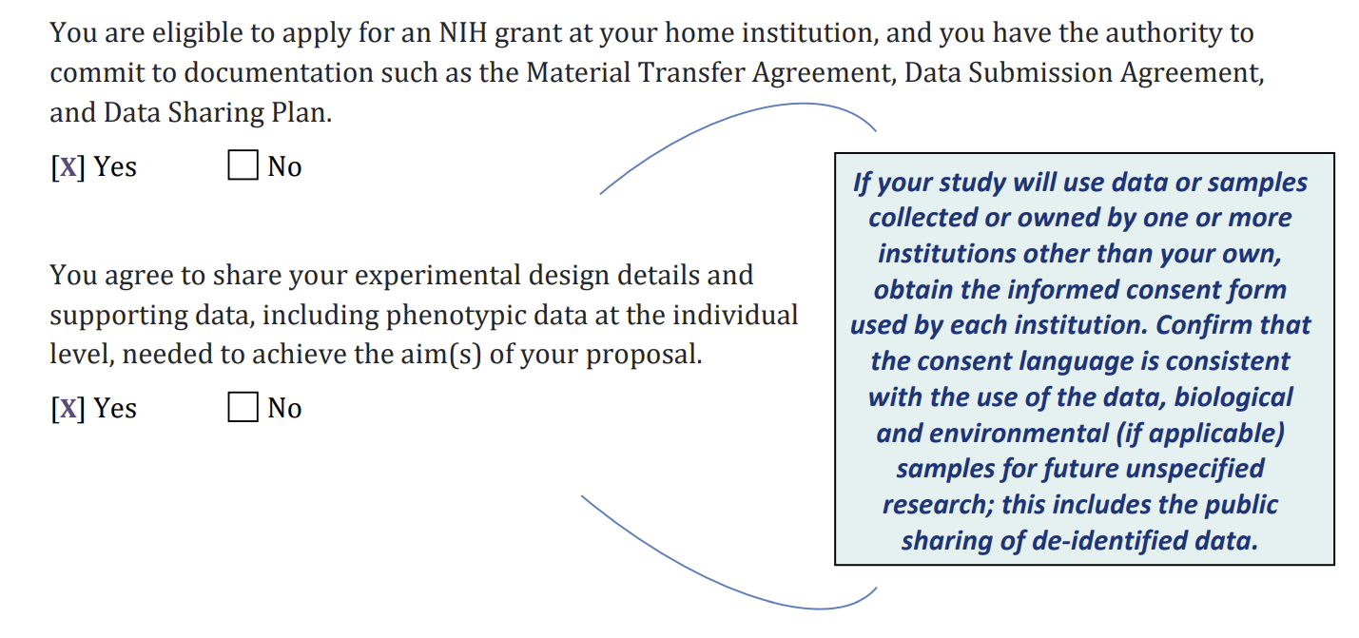
Other tips – Material Transfer & Data Sharing
CRITICAL: Be sure the materials and data from all involved sites/cohorts are able to be shared.
You will be required to submit all project data needed to achieve the aims of your proposal to the HHEAR Data Center before your samples will be analyzed. This will include phenotypic data at the individual level.
Notes:
Because it is so CRITICAL, we want to reiterate that you need to be sure that you or your collaborators have the authority to commit to the material transfer agreement and the data sharing documentation for samples and data from all involved sites and cohorts.
Additionally, you should confirm that all of the project data needed to achieve the aims of your proposal is available to be submitted.
If your project is approved and then you find you are unable to submit or share all required data, your project may be stopped.

Slide 19
Other tips – Reminders
Experts in your field may not be reviewing your application.
Write your specific aims, significance and research strategy so that non-experts can easily understand.
Before You Apply
Investigators should take advantage of HHEAR consultative services in the early stages of formulating their proposal.
Contact the HHEAR Coordinating Center at HHEARHelp@westat.com to request a pre-submission consultation.
Notes:
Do not expect that only experts in a specific field will be reviewing applications.
HHEAR review groups will include people with broad expertise in environmental epidemiology and exposure science but who may not have a deep expertise in the particular field of an application.
Write your specific aims, significance, and research strategy, including study design, methods, and procedures used to collect and analyze the data, so that other scientists can evaluate your application.
Be sure to take advantage of HHEAR consultative services as needed. A pre-submission consultation can be requested by email at HHEARHelp@westat.com.

Slide 20
Other tips – Example Application
An example of a successful HHEAR application is available as a supporting resource.
This document provides guidance and important considerations for submitting high quality applications.
Investigators are encouraged to review the document before submitting an Initial Application for HHEAR services.
Excerpt from HHEAR Example Application: https://hhearprogram.org/sites/default/files/HHEAR-SampleApplication-508.pdf
Notes:
In addition to the tips available in this module, there is an annotated example application available on the HHEAR website.
It provides an example of a successful HHEAR application and is available as a supporting resource.
The annotations in this document provide guidance and important considerations for submitting high-quality applications.
Investigators are encouraged to review this document before submitting an Initial Application for HHEAR services.
Please note the link to the example application in the lower right corner of the slide.

Slide 21
Other tips – Resources
Refer to the following webpages for more information:
Research Priorities
https://hhearprogram.org/research-priorities
Eligibility
https://hhearprogram.org/are-you-eligible-hhear-services
Policies
https://hhearprogram.org/policies
Notes:
As a reminder there is additional information available on the HHEAR website such as Research Priorities, Eligibility, and Policies… each of which is linked on this slide.
Good luck with your application, and we are here to help!

